Slide 1





EBS Pacific cod
BSAI Groundfish Plan Team
Steven J. Barbeaux, Lewis Barnett, Jason Connor, Julie Nielson, S. Kalei Shotwell, Elizabeth Siddon, and Ingrid Spies
November, 2022

Slide 2
Stock Overview
Tier: 3b
Area: Eastern Bering Sea (EBS) and Northern Bering Sea (NBS)
Current year status
BRIEF summary of changes to the current assessment data/model

Slide 3
Teams or SSC Comments
Given that an ensemble model structure has been endorsed by the SSC in 2021, representing a fairly large change in the assessment process, if the new authors choose to propose an ensemble in the future it may be prudent to minimize changes to the suite of models comprising the ensemble so that the potential benefits of a stable ensemble can be realized.
The authors presented a series of minor changes to the model this year. The Plan Team and SSC endorsed removing of the weight-at-length adjustments and the aging bias for post-2007. These model changes resulted in very minimal changes to the resulting model and are described in the document below.
Notes:
PT/SSC comments being addressed IN THIS PRESENTATION ONLY

Slide 4
Teams or SSC Comments
If model ensembles are brought forward in the future, the authors should work with the BSAI GPT to define a process whereby GPT members themselves assign model scores based on the same, or an updated set, of scoring criteria. This would allow for future development of ensemble member weightings based upon independent review, and the SSC believes this would address one of the concerns highlighted in public comment.
In light of the above recommendation, model changes were kept to a minimum and the weighting criteria used for this year’s ensemble were judged to rate the same as the weights generated by the CIE and endorsed by the SSC in 2021.
Notes:
PT/SSC comments being addressed IN THIS PRESENTATION ONLY

Slide 5
Teams or SSC Comments
The SSC recommends that inclusion of [fishery age composition data] be fully explored in a later assessment cycle, either within a single model or multiple ensemble members, highlighting that it views this as a top priority for future research.
Given the already monumental task of taking this stock over from Dr. Thompson, the authors chose not to investigate the use of fishery age composition data. This also in light of the SSCs recommendation to minimize changes to the suite of models comprising the ensemble. The authors intend to investigate the use of fishery age composition data in the future.
Notes:
PT/SSC comments being addressed IN THIS PRESENTATION ONLY

Slide 6
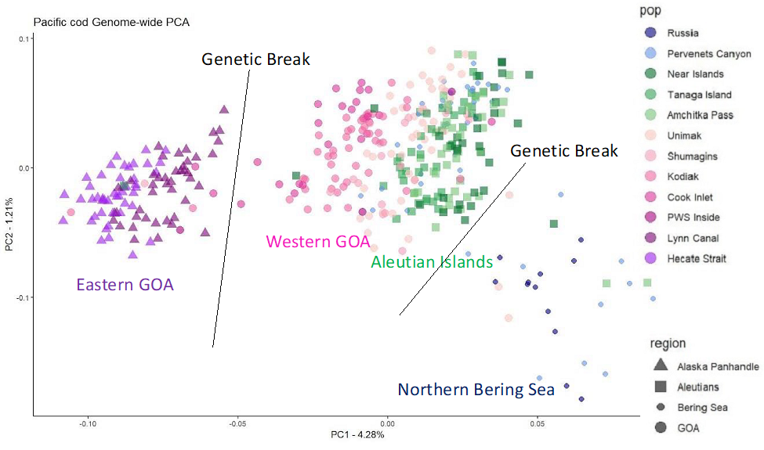
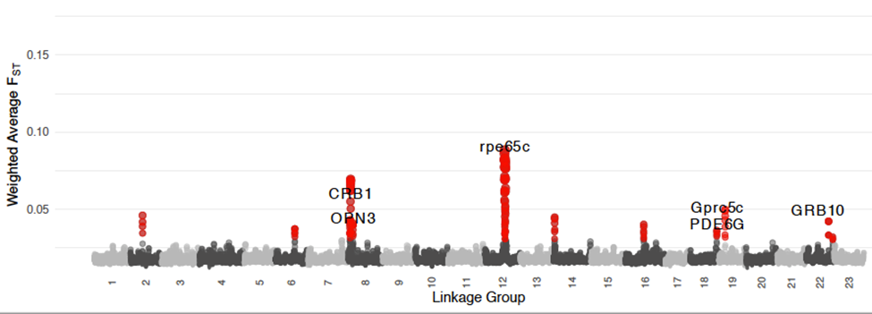
Pacific cod genetics
Isolation-by-distance
western Gulf of Alaska through Unimak Pass and eastern Aleutian Islands
Break in the population structure between western and eastern GOA
Break western Bering Sea shelf, adjacent to Russia, and all other regions.
Aleutian Island populations are highly diverged at a few genomic regions that may be adaptively significant
Notes:
PT/SSC comments being addressed IN THIS PRESENTATION ONLY

Slide 7
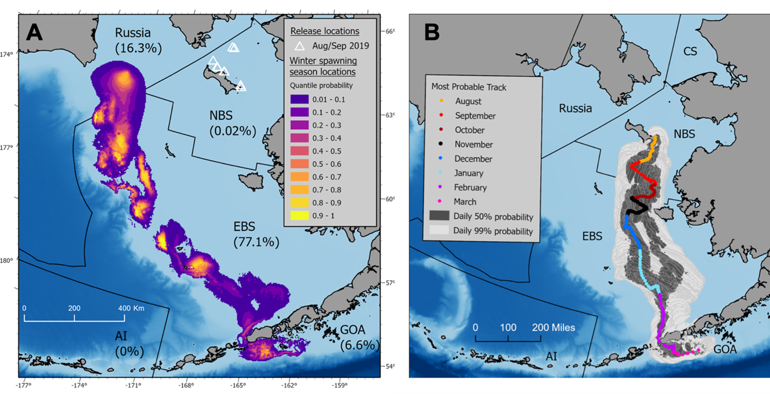
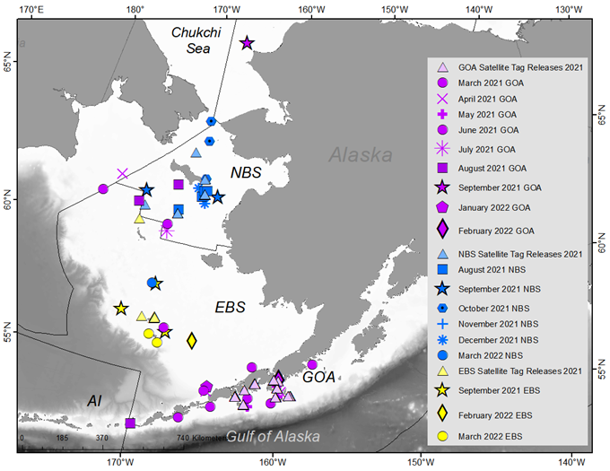
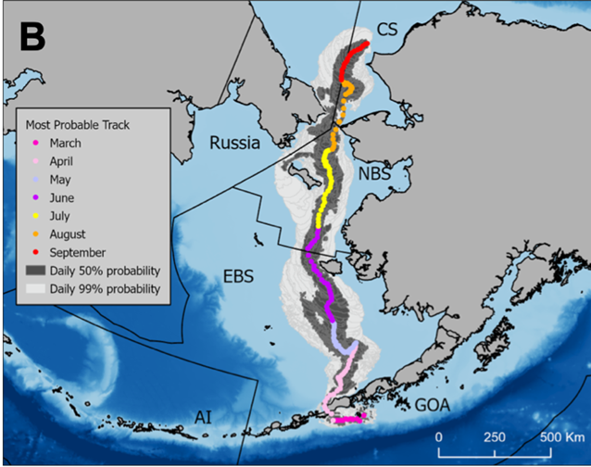
Pacific cod PSAT
Notes:
PT/SSC comments being addressed IN THIS PRESENTATION ONLY

Slide 8
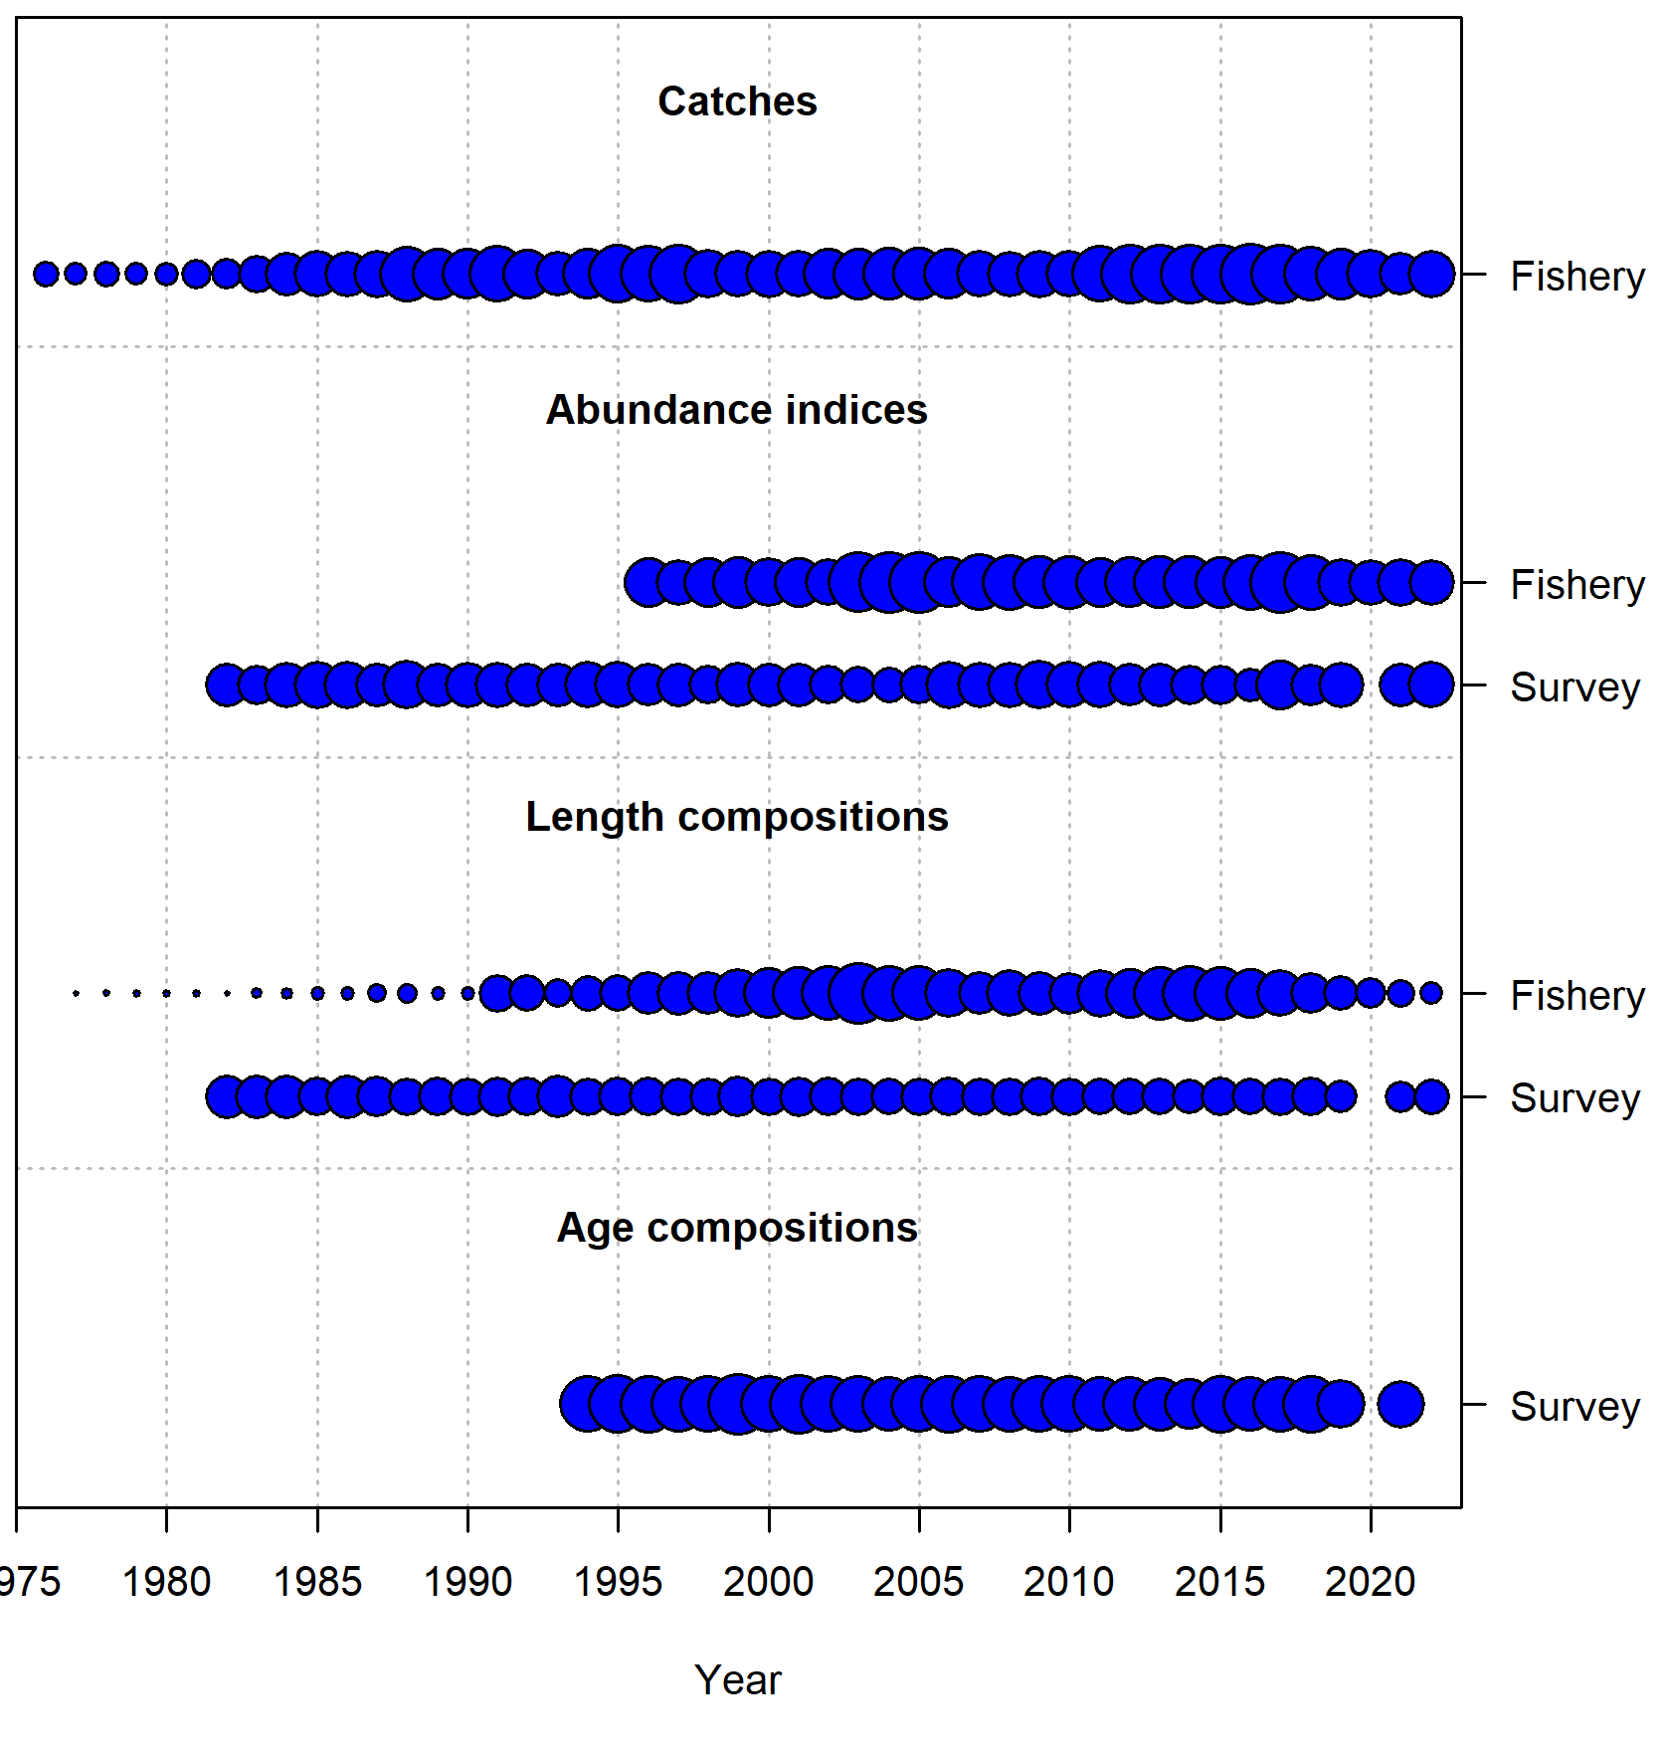
Data Summary
Source | Type |  | Years
Fishery |  | Catch biomass | 1977-2022
Fishery |  | Catch size composition | 1977-2022
Fishery |  | Catch per unit effort (VAST) | 1996-2022
EBS+NBS trawl survey |  | Survey numerical abundance (VAST) | 1982-2019, 2021-2022
EBS+NBS trawl survey |  | Survey age composition (VAST) | 1994-2019,2021
Notes:
Time series graph or table of data used in the model, specify years (try to avoid presenting data not used in the model unless presented to provide support for model evaluation)

Slide 9
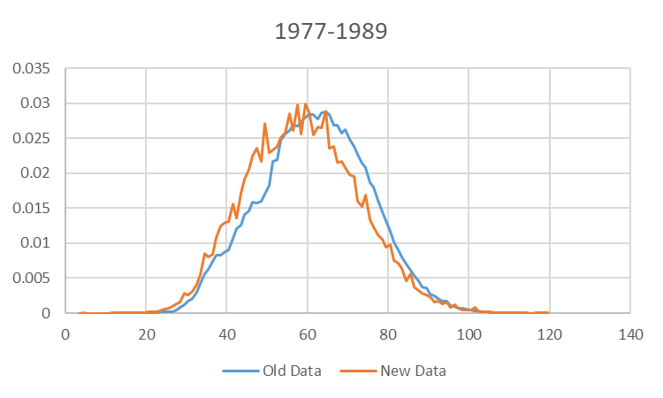
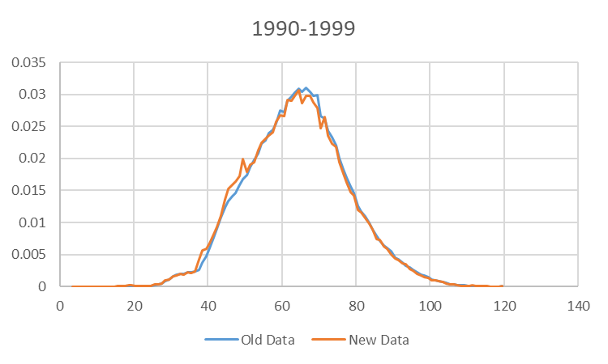
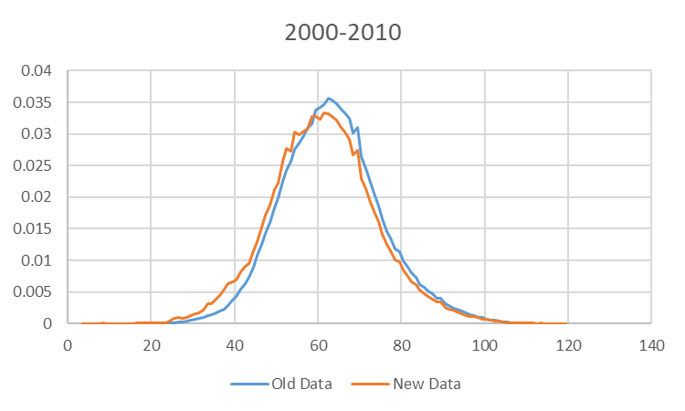
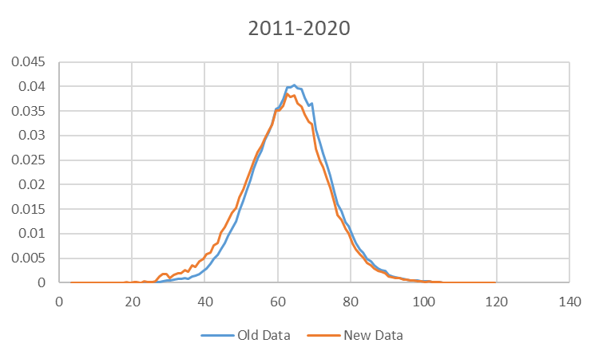
Data changes Fishery Length Composition
New algorithm for constructing fishery length composition (described in September)
Data weighted by haul, vessel, gear, month, NMFS area, and year
Resulted in shift to more smaller fish in distribution
Notes:
Time series graph or table of data used in the model, specify years (try to avoid presenting data not used in the model unless presented to provide support for model evaluation)

Slide 10
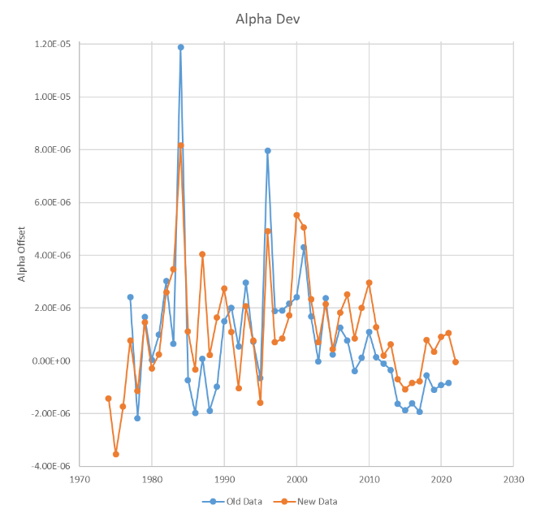
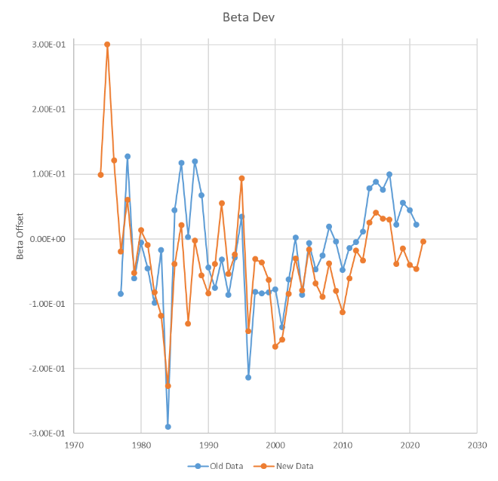
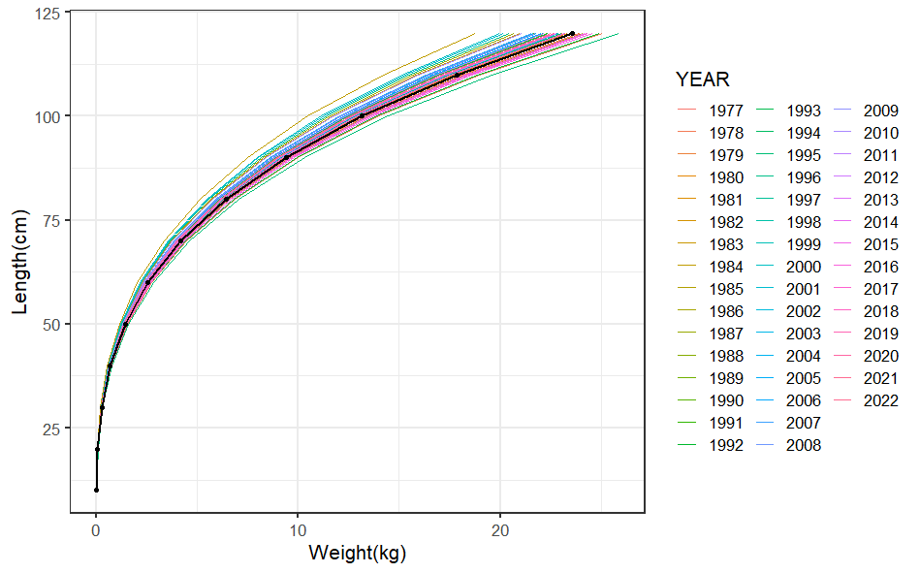
Data changes – Annual Weight-at-Length Adjustments
Switch from linear Mathcad algorithm to GAM in R mgcv library (described in September)
Similar resulting trend in adjustments
Notes:
Time series graph or table of data used in the model, specify years (try to avoid presenting data not used in the model unless presented to provide support for model evaluation)

Slide 11
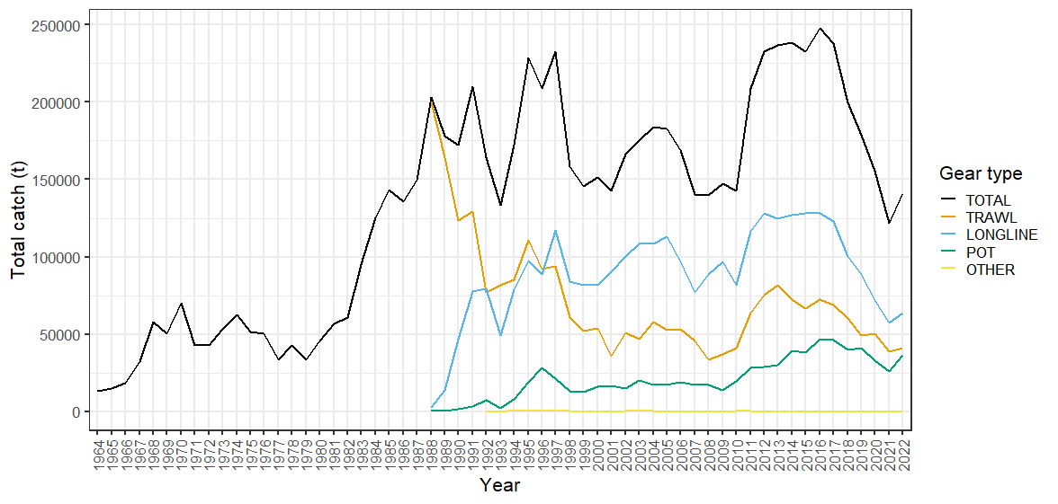
Catch – Fishery Sector
Increase in catch from 2021 but lower than 10-year average
Longline remains dominant
Continued increasing trend in pot proportion and decreasing trend in trawl proportion
Notes:
Time series with highlights of trends and any issues (e.g., overages, data issues, discards), provide regional breakdown time series or spatial distribution maps only if relevant to data interpretation or model evaluation

Slide 12
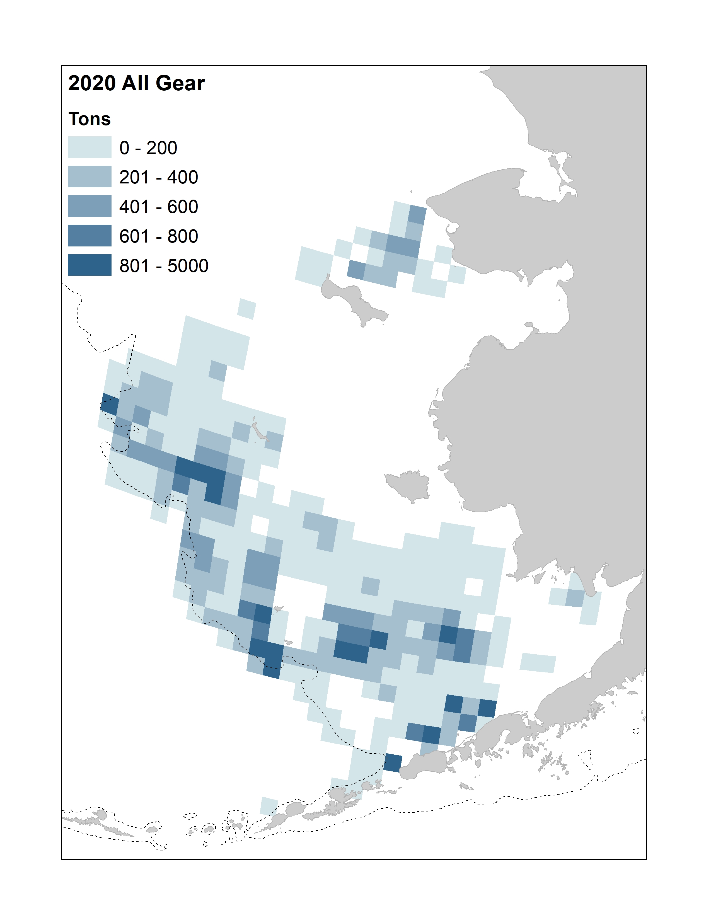
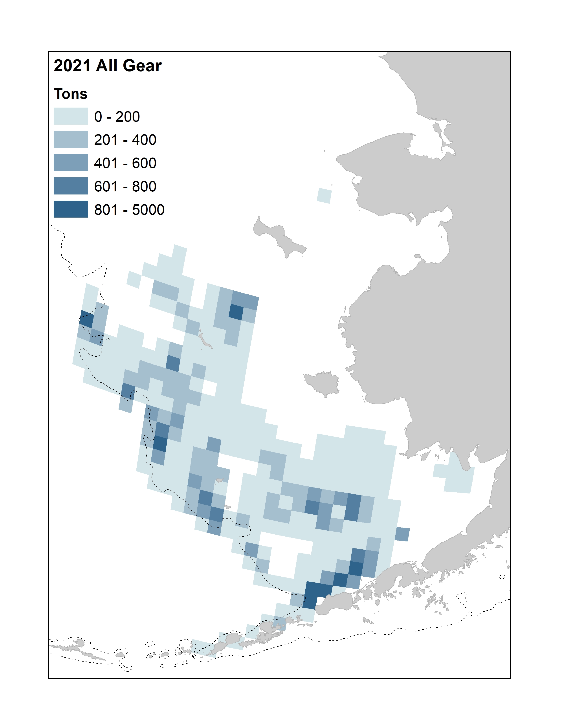
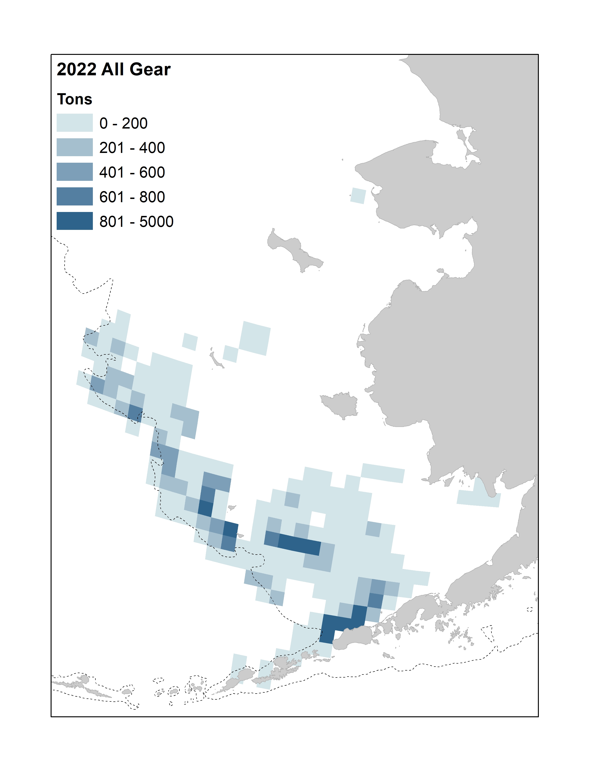
Catch – Distribution
Shift to southwest
Through October 9, 2022
Notes:
Shifting fishery to the southwest in 2022 and continued shift away from the NBS as temps cool.

Slide 13
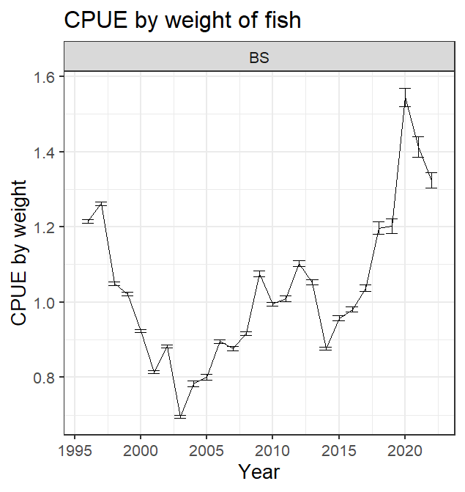
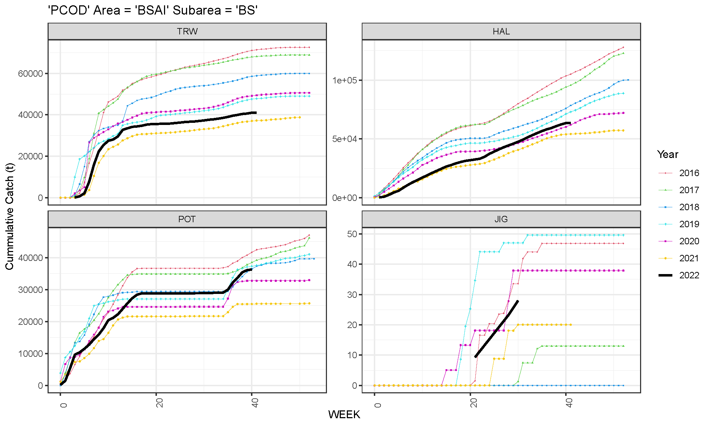
Catch – Cumulative and RAW CPUE
Catch rates better than 2021
Raw aggregated CPUE lower than 2021, but remains higher than average

Slide 14
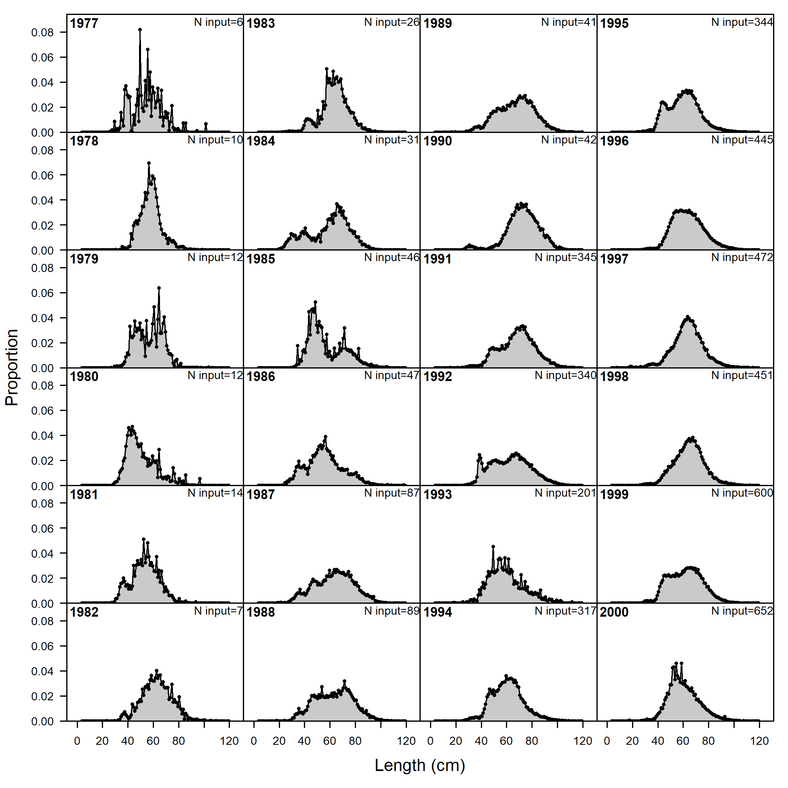
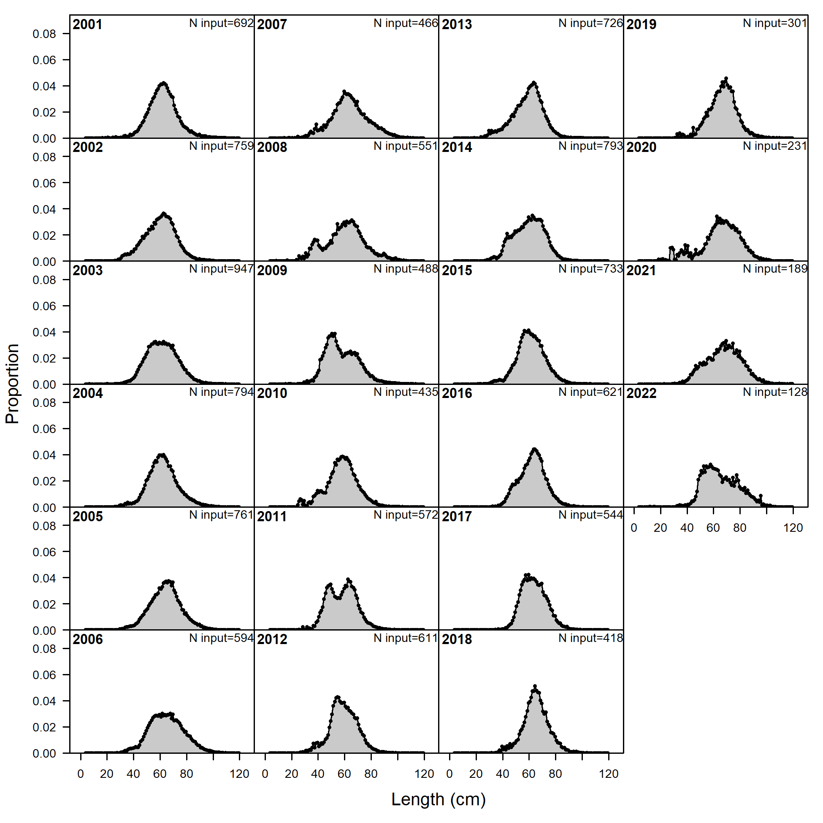
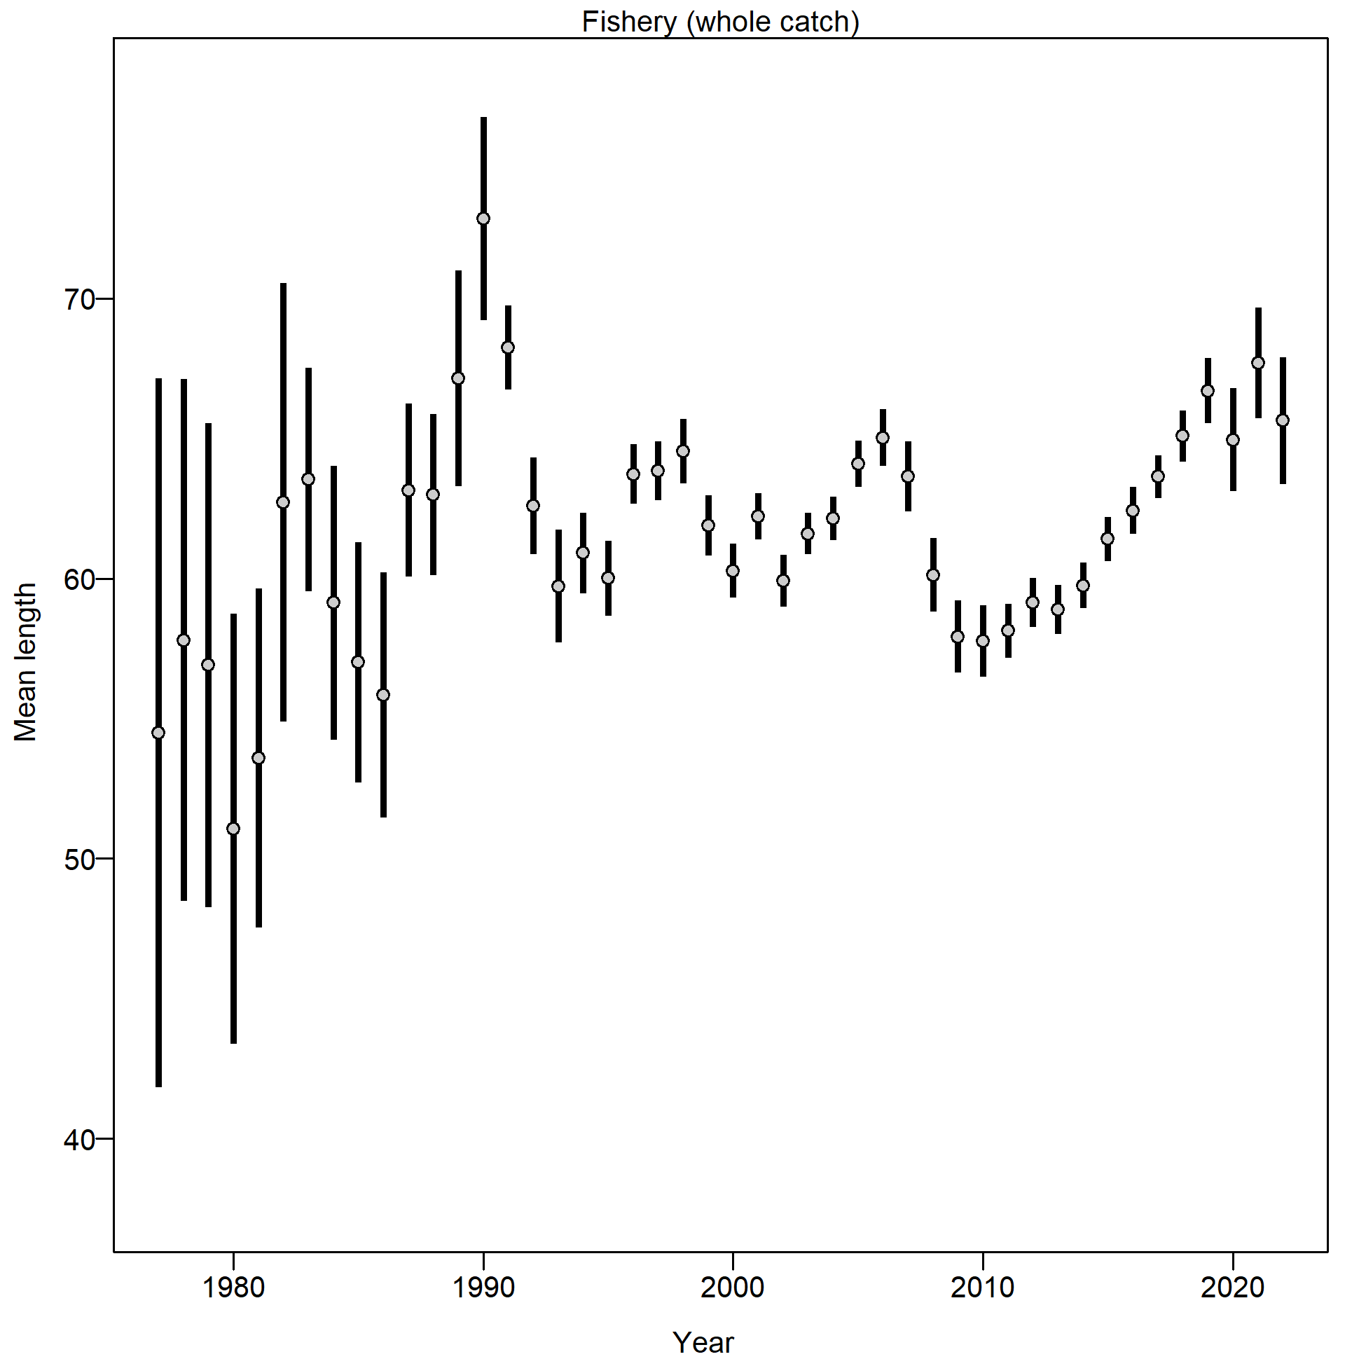
Fishery Size Composition
Relatively stable size for previous 5 years
Notes:
Increase in mean length from 2010-2015, with realatively stable mean length over previous 5 years.

Slide 15
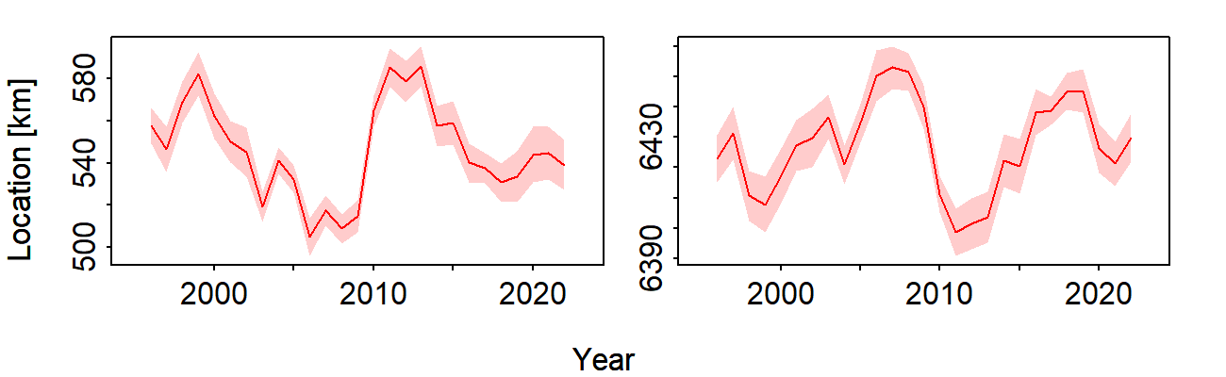
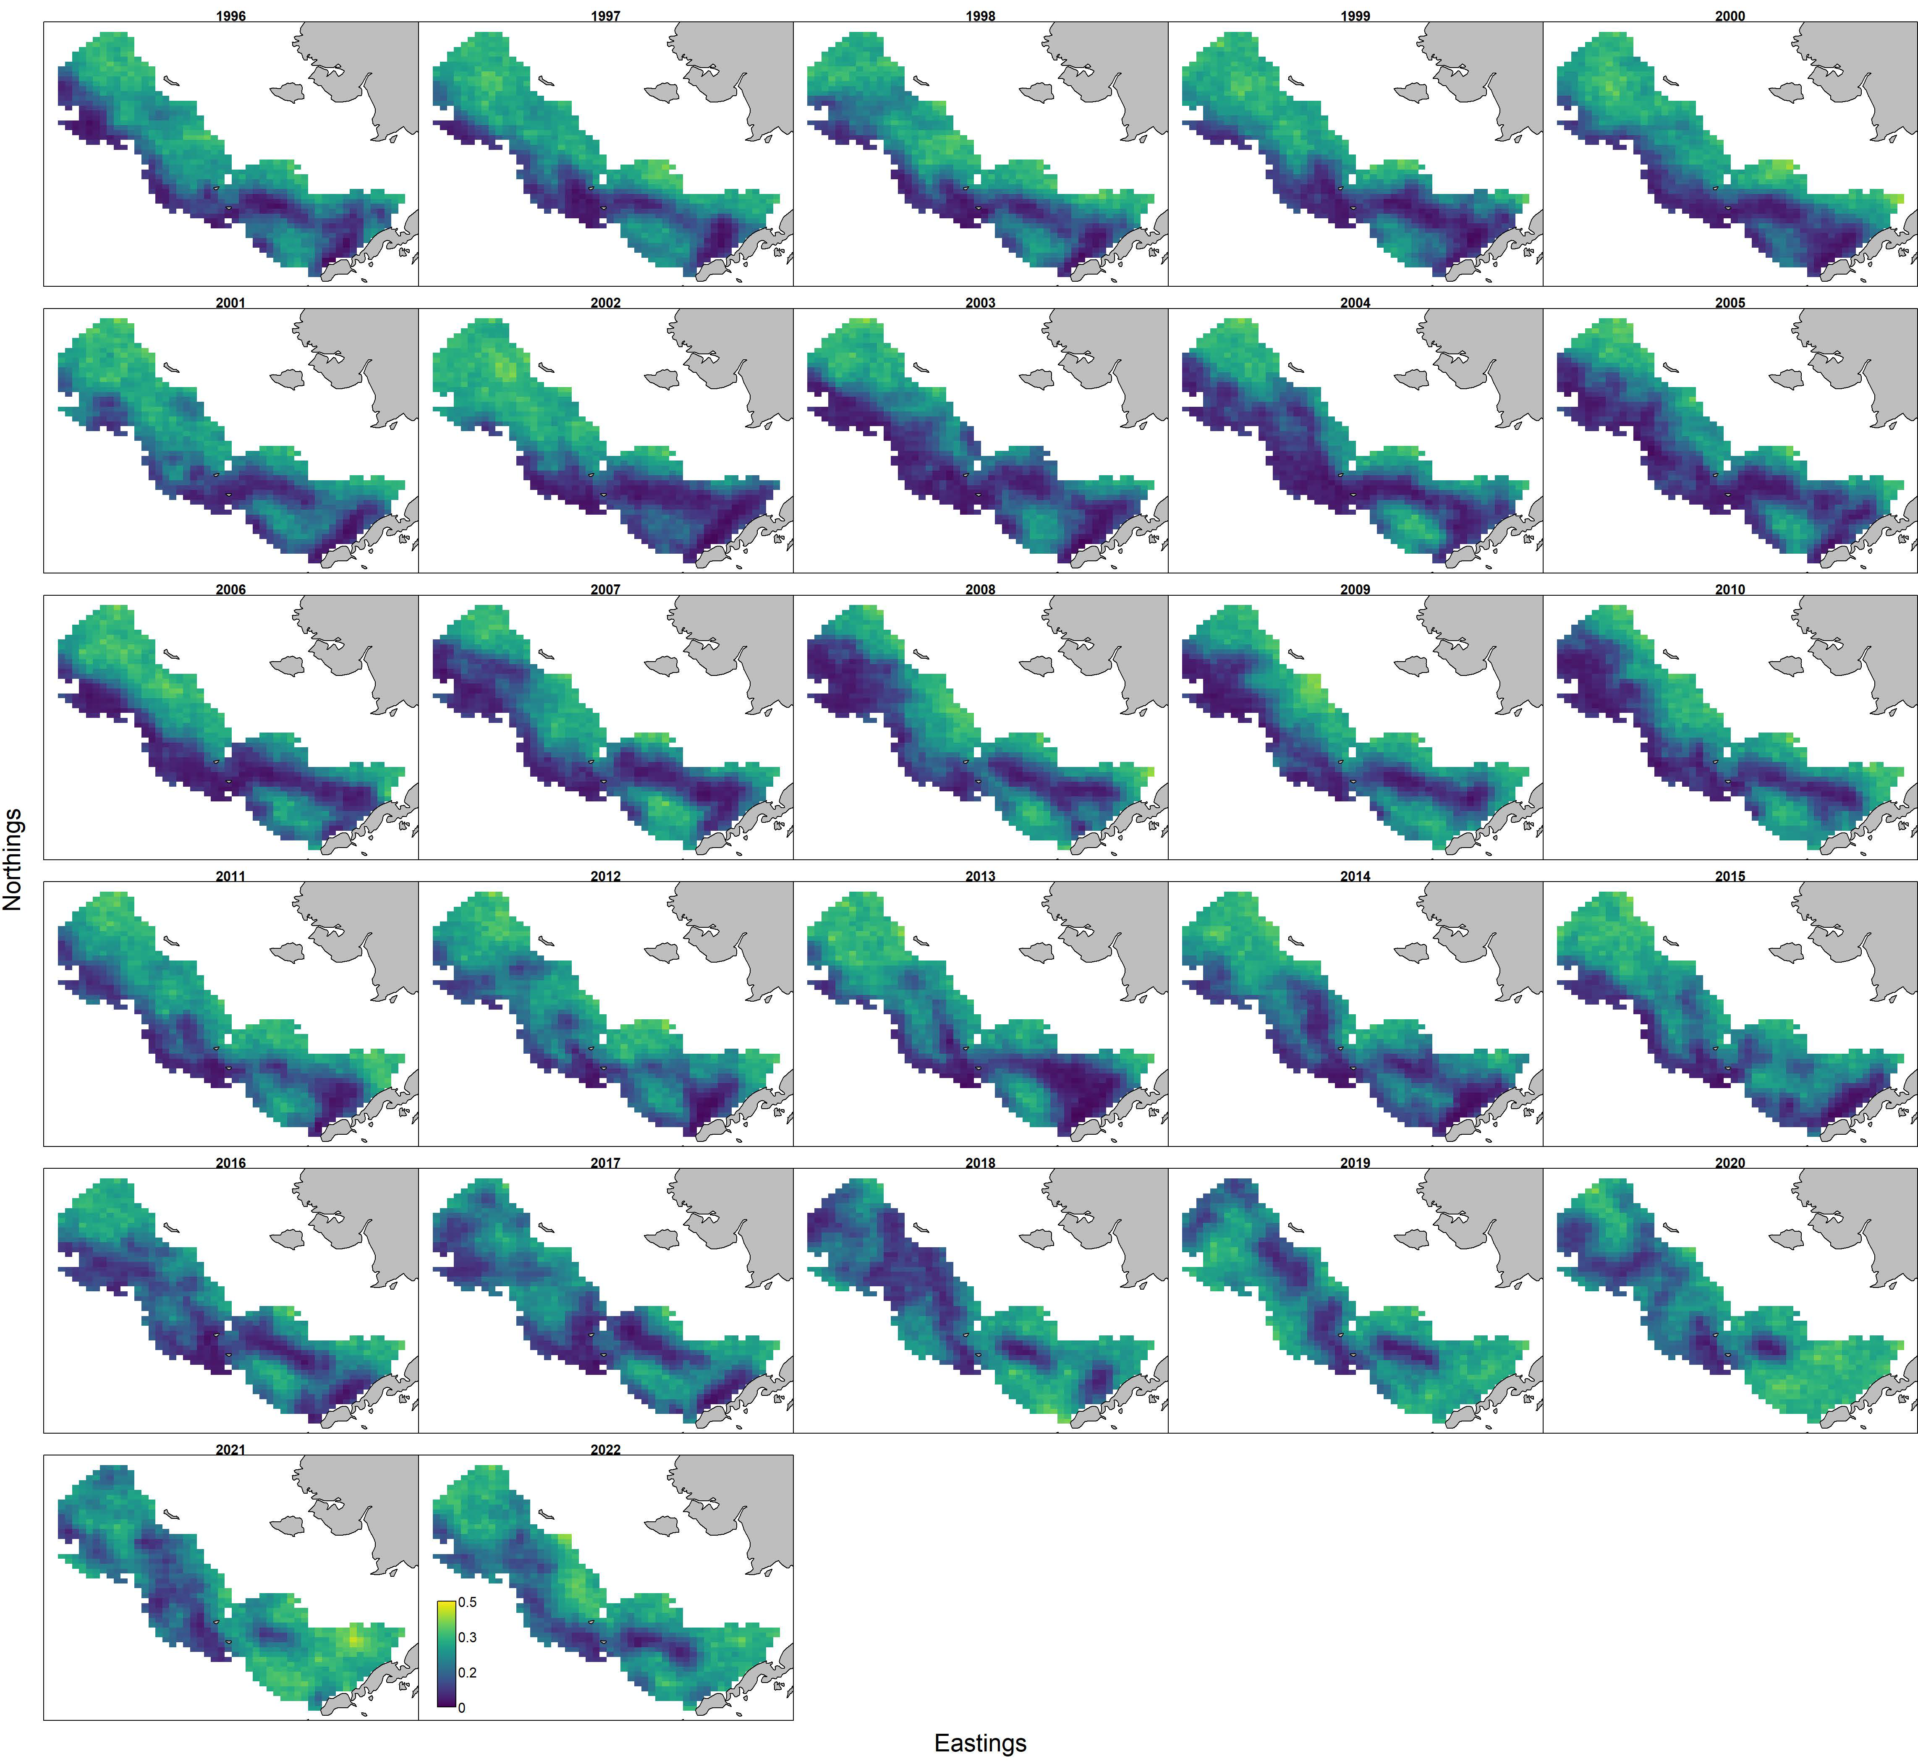
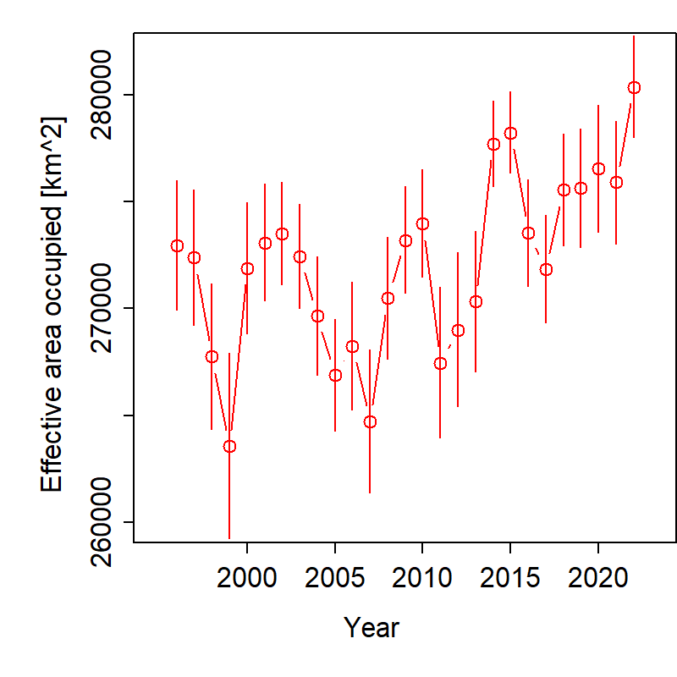
VAST CPUE Index – Jan-Feb Longline Fishery
Eastings (km)
Northings (km)
COG shifted to the northwest since 2021
Overall extent has continued to increase
Notes:
Time series with highlights of trends and any issues (e.g., survey method changes, data issues), use separate slides for different survey time series, provide regional breakdown time series or spatial distribution maps only if relevant to data interpretation or model evaluation, may include exploratory surveys if relevant to model interpretation, otherwise limit

Slide 16
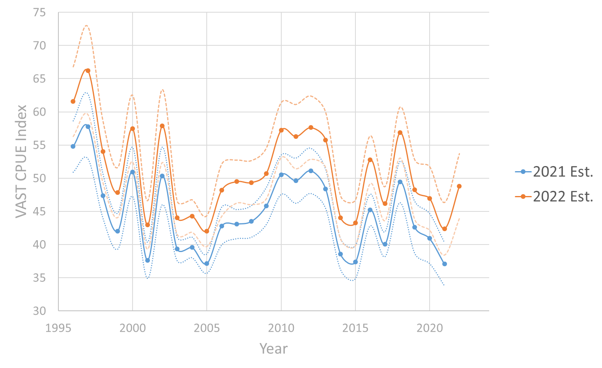
VAST CPUE Index – Jan.-Feb. Longline Fishery
Difference in spatial extent resulted in overall inflation of index
Trend remains the same with high correlation between indices
15% Increase in 2022 from 2021
Notes:
Time series with highlights of trends and any issues (e.g., survey method changes, data issues), use separate slides for different survey time series, provide regional breakdown time series or spatial distribution maps only if relevant to data interpretation or model evaluation, may include exploratory surveys if relevant to model interpretation, otherwise limit

Slide 17
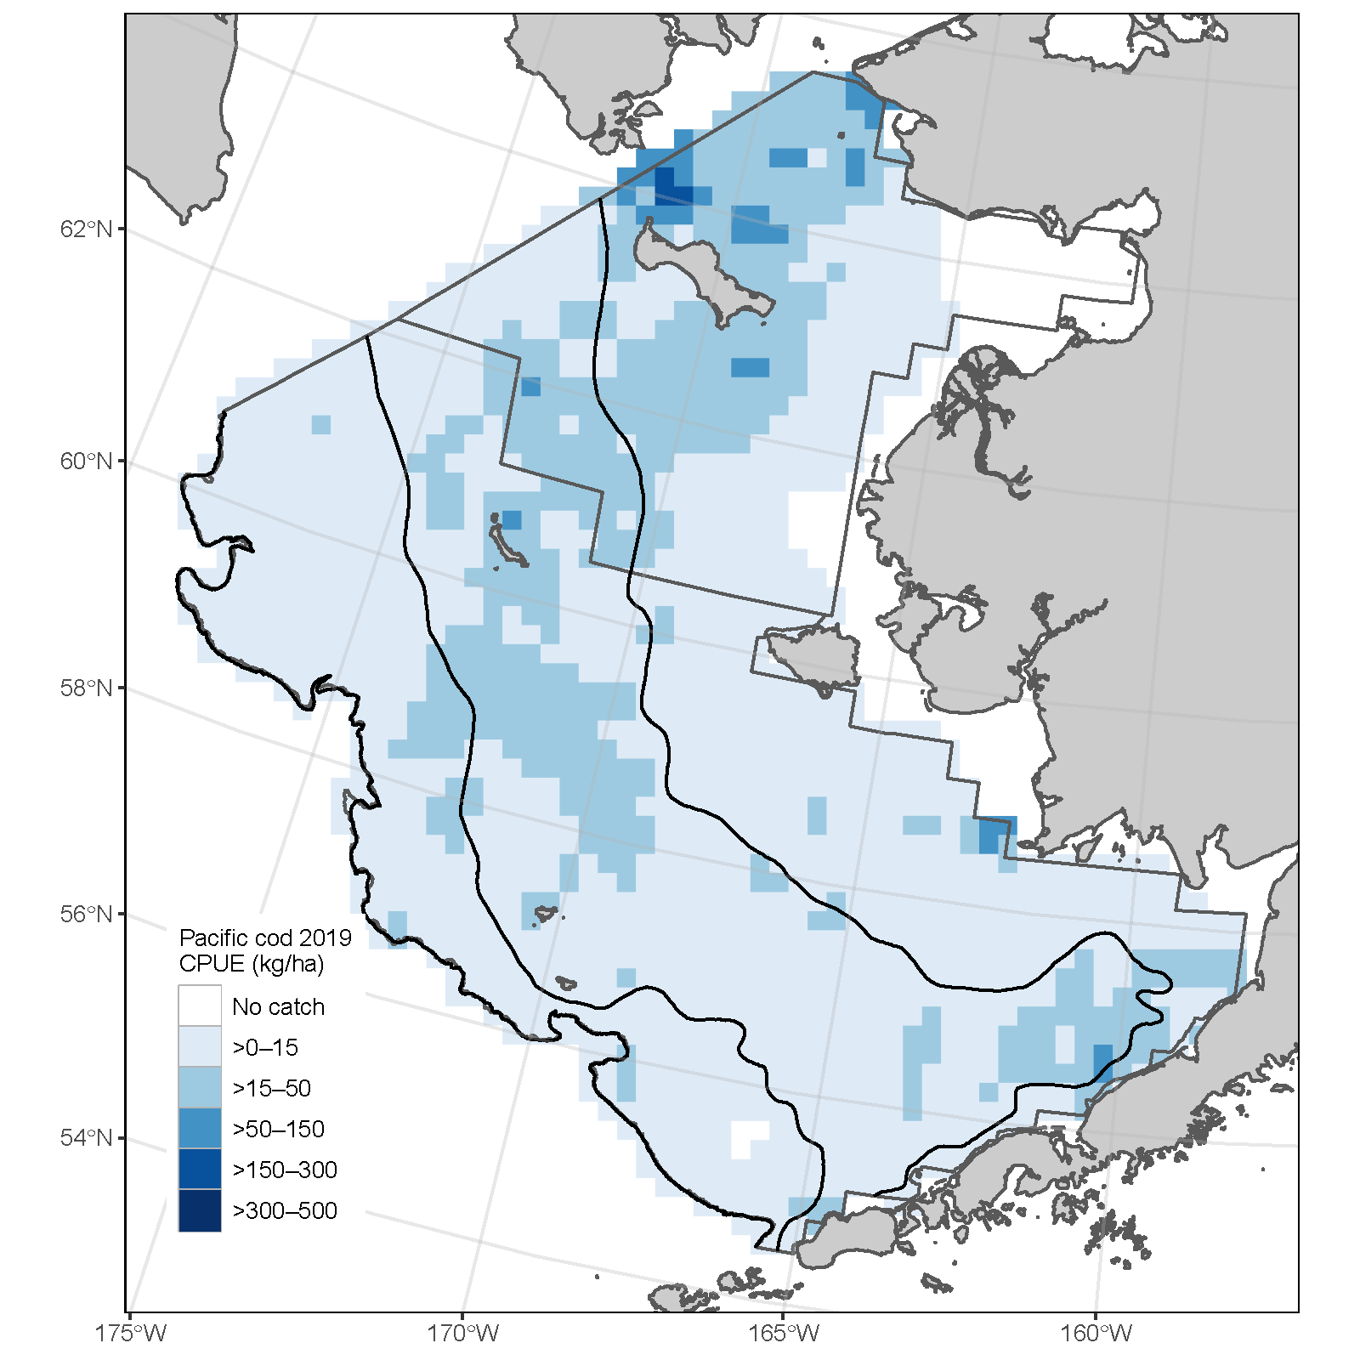
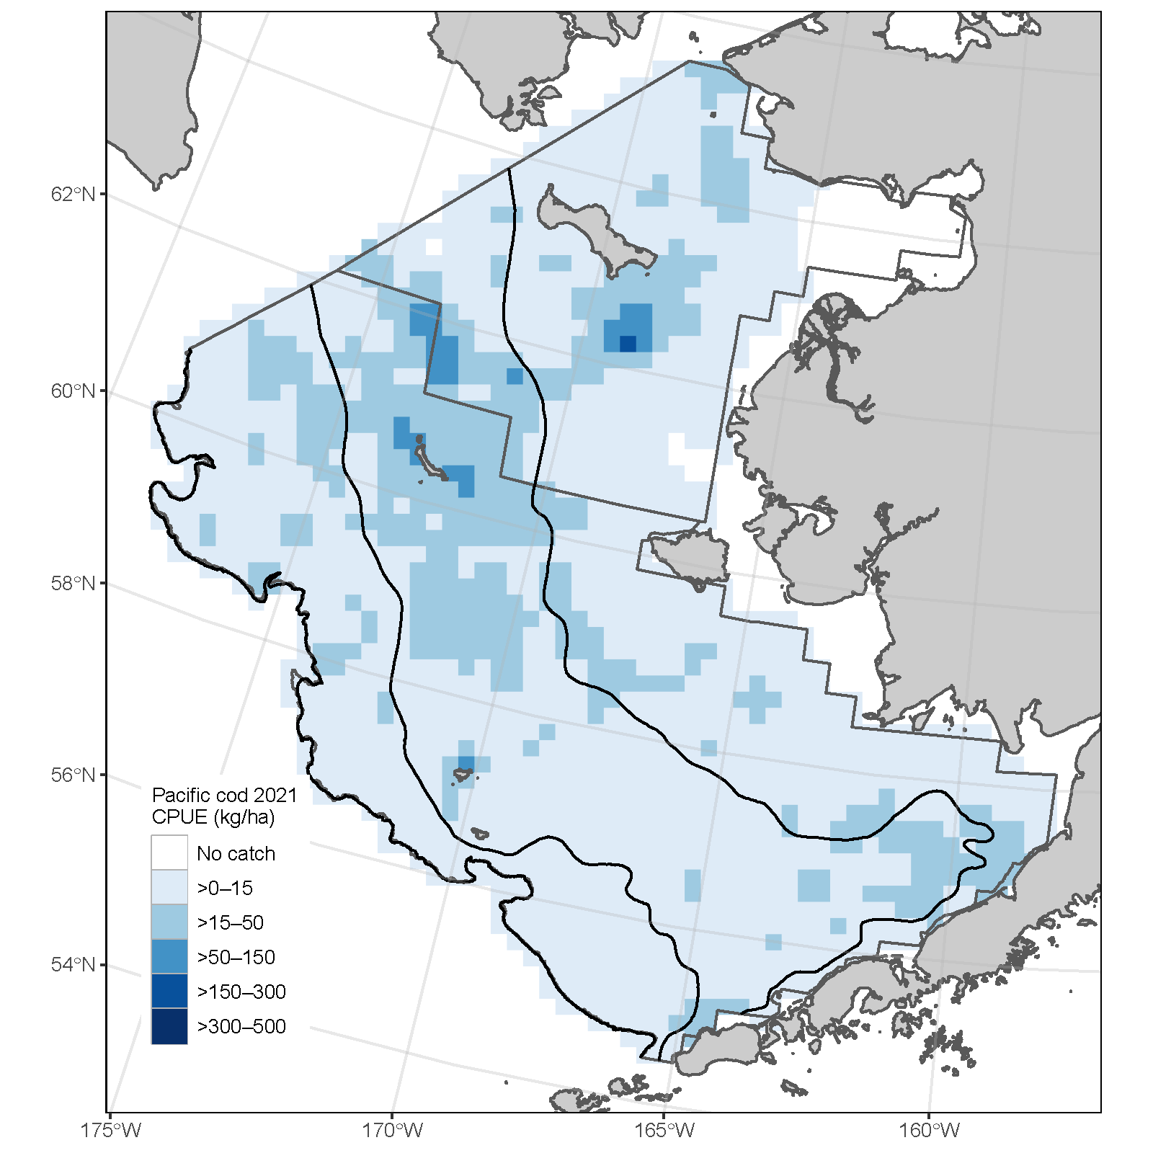
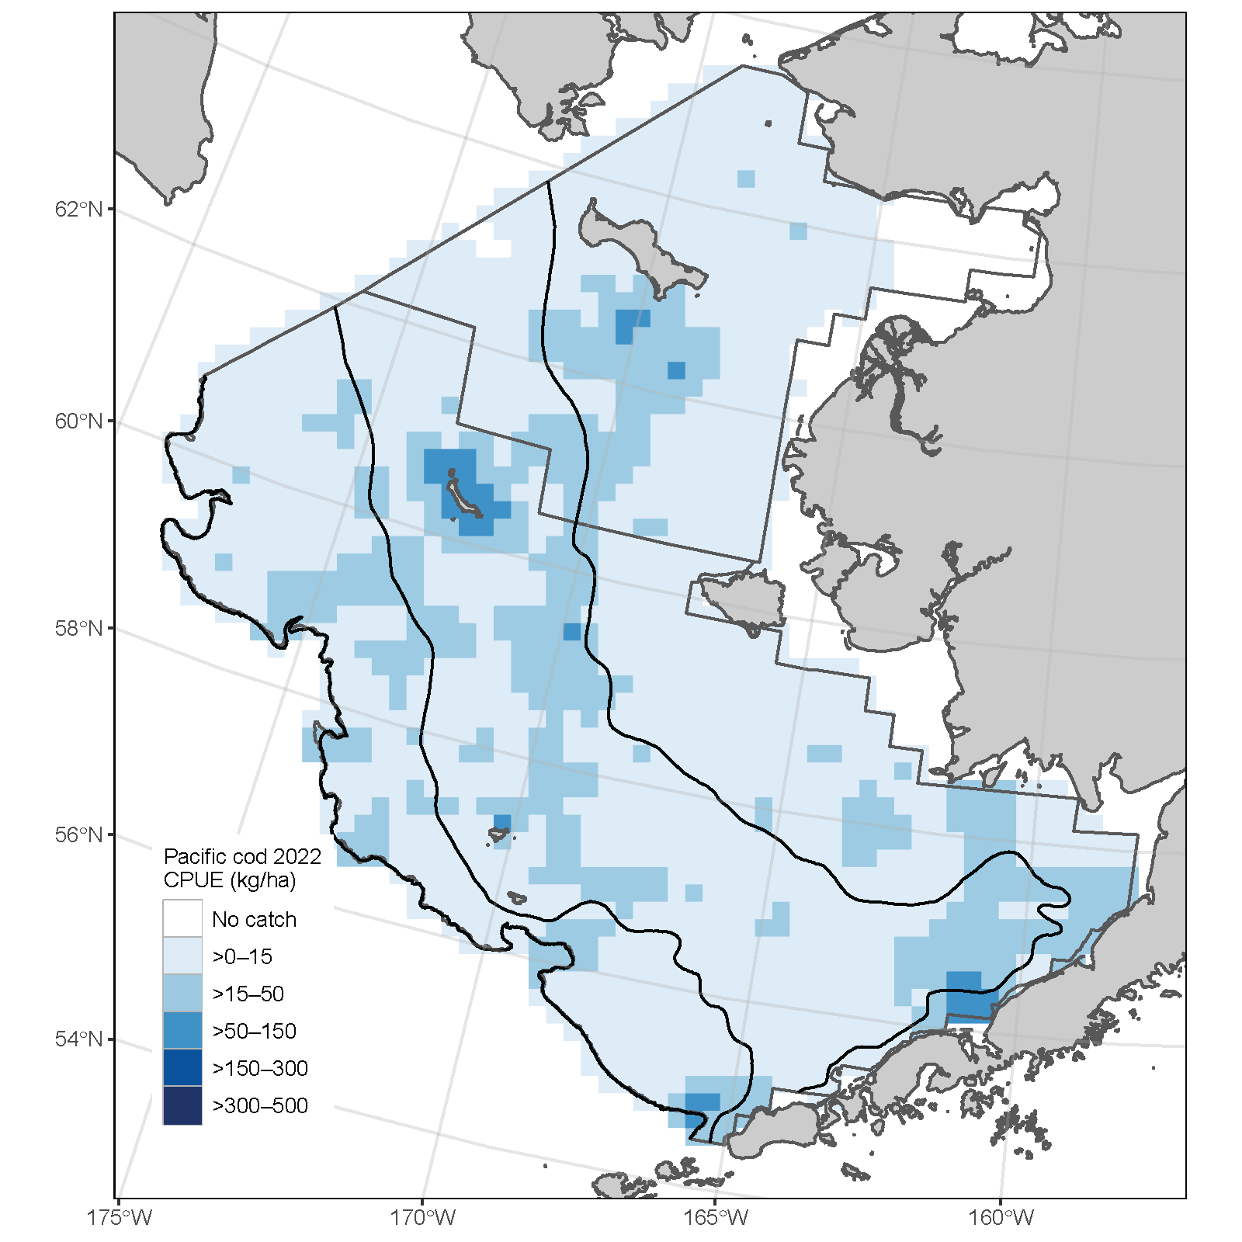
Survey – Bering Sea Shelf Bottom Trawl
2019 2021 2022
Shift to southeast
Notes:
Distribution shifting south of St. Laurance.

Slide 18
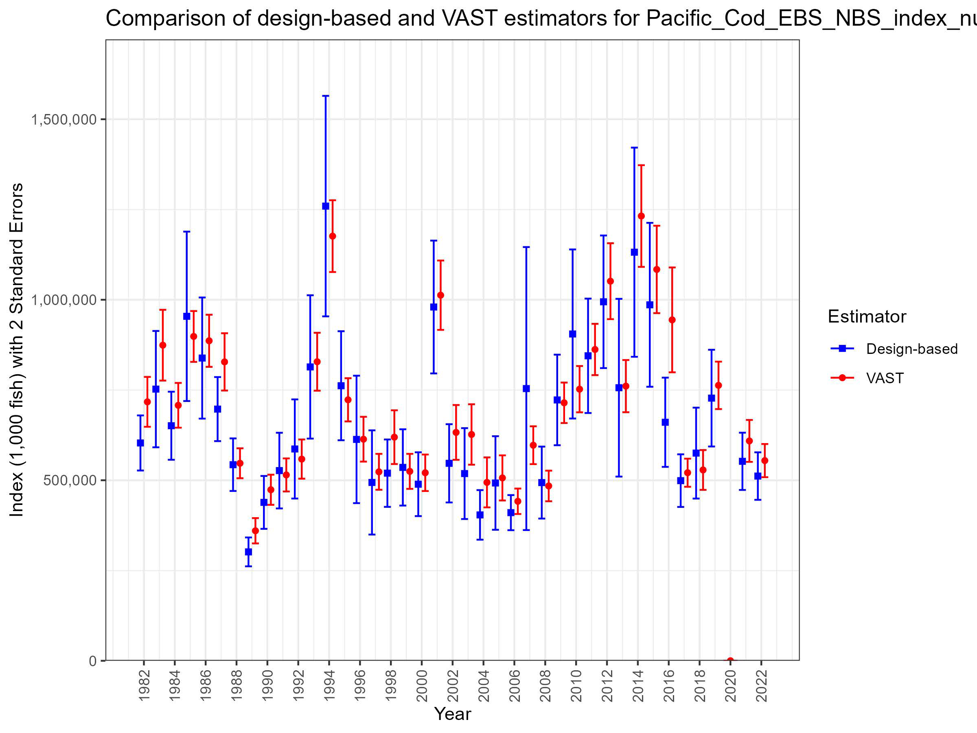
VAST Survey Index – Bering Sea Shelf Bottom Trawl
VAST NBS and EBS bottom trawl survey data
Cold-pool extent index as a covariate
Notes:
Time series with highlights of trends and any issues (e.g., survey method changes, data issues), use separate slides for different survey time series, provide regional breakdown time series or spatial distribution maps only if relevant to data interpretation or model evaluation, may include exploratory surveys if relevant to model interpretation, otherwise limit

Slide 19
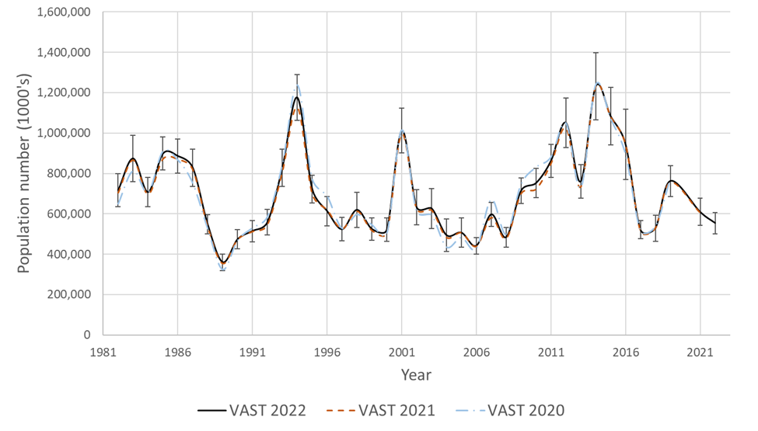
VAST Survey Index – Bering Sea Shelf Bottom Trawl
Small changes in time series from previous years
8.9% decrease in 2022 abundance from 2021
Notes:
Time series with highlights of trends and any issues (e.g., survey method changes, data issues), use separate slides for different survey time series, provide regional breakdown time series or spatial distribution maps only if relevant to data interpretation or model evaluation, may include exploratory surveys if relevant to model interpretation, otherwise limit

Slide 20
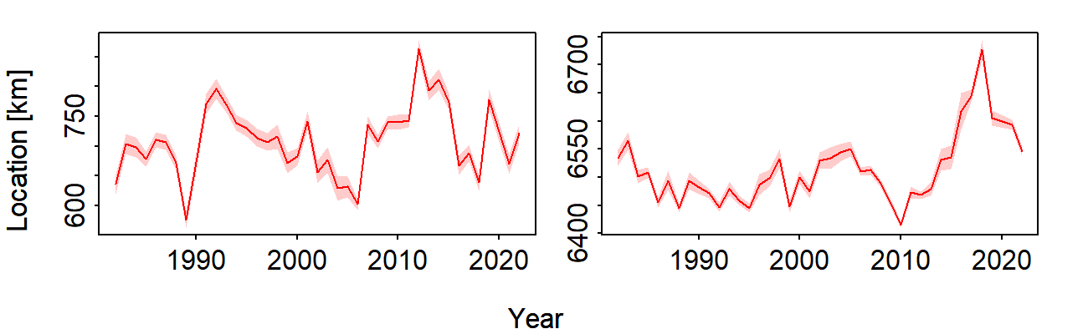
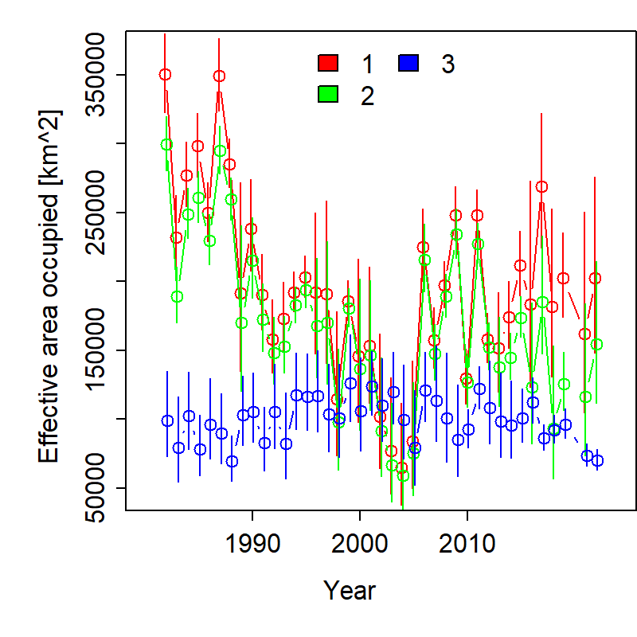
VAST Survey Index – Bering Sea Shelf Bottom Trawl
Eastings (km)
Northings (km)
COG shifted to the southeast since 2021
Overall extent has increased, while decreasing in the NBS since 2021
Notes:
Time series with highlights of trends and any issues (e.g., survey method changes, data issues), use separate slides for different survey time series, provide regional breakdown time series or spatial distribution maps only if relevant to data interpretation or model evaluation, may include exploratory surveys if relevant to model interpretation, otherwise limit

Slide 21
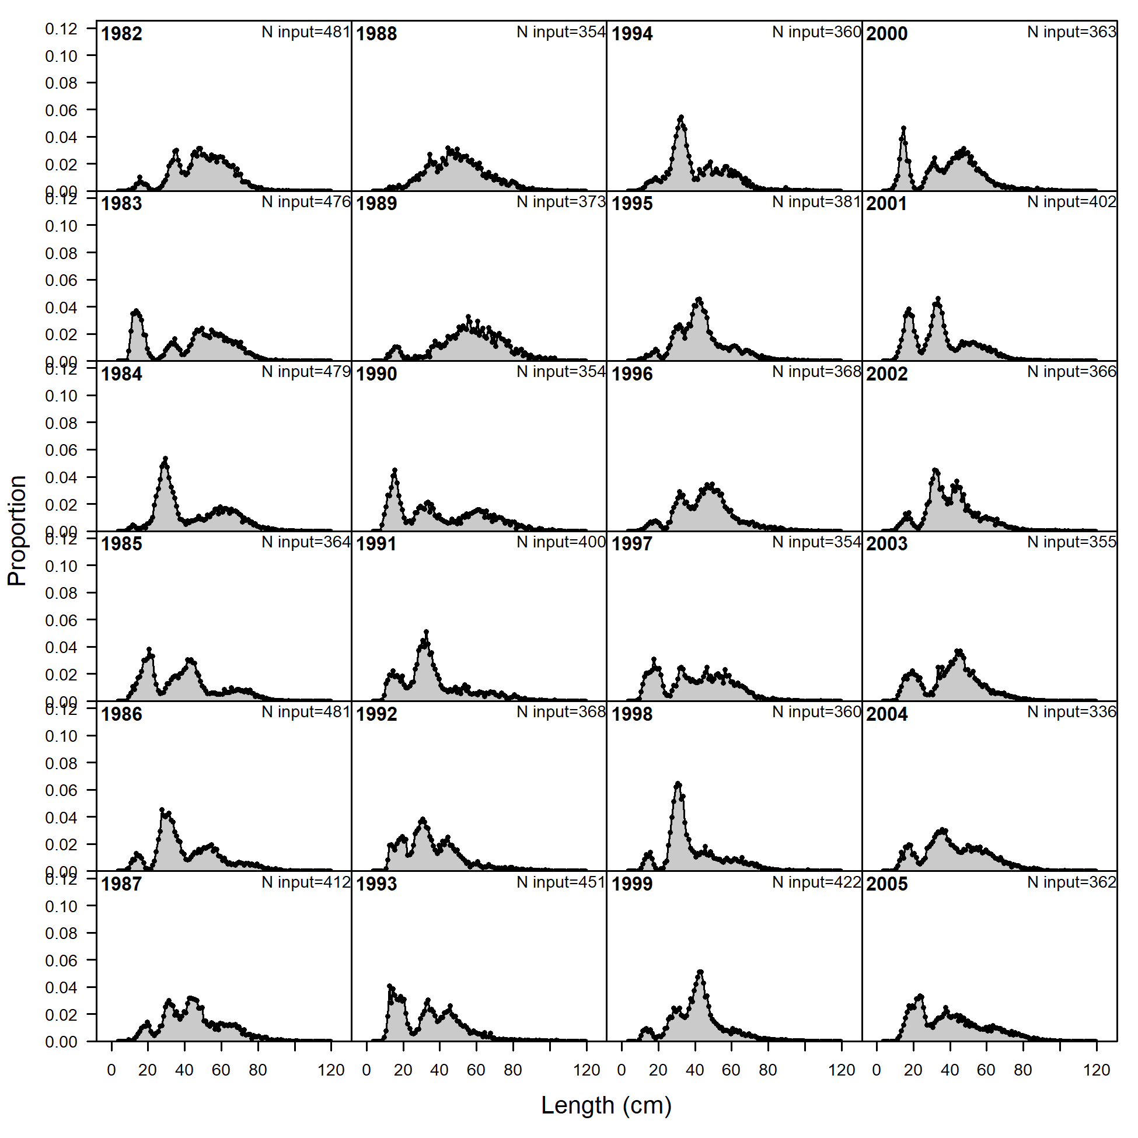
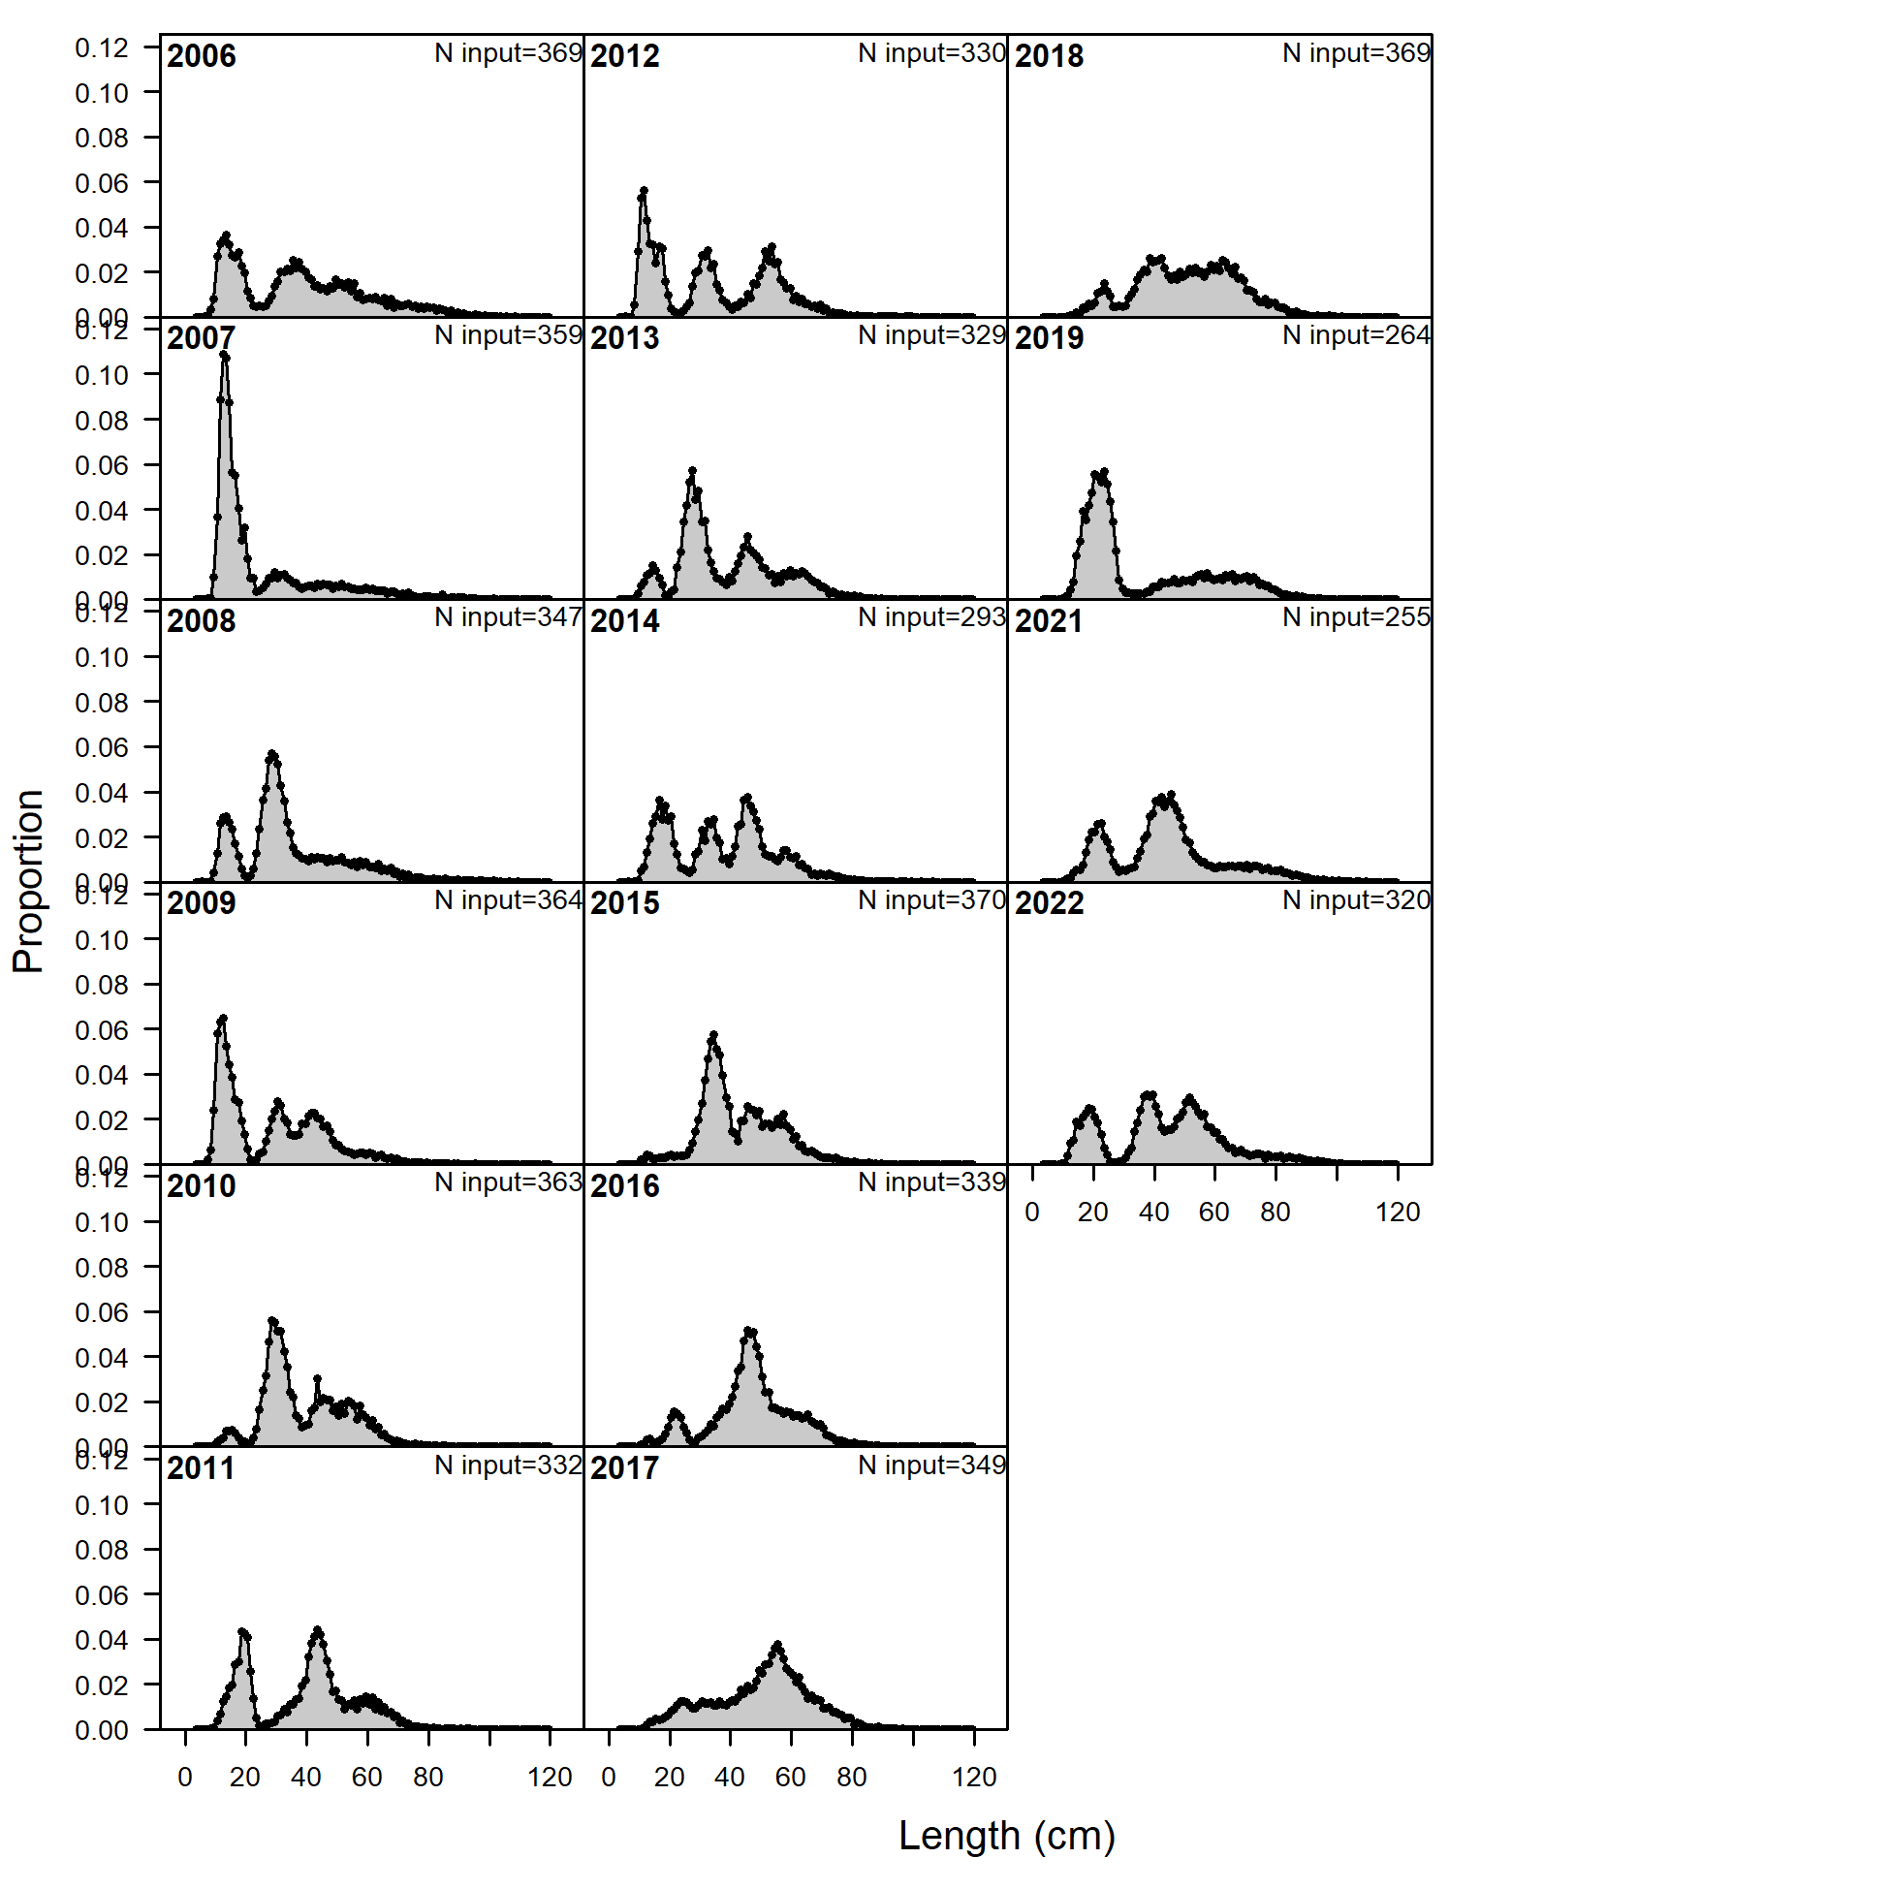
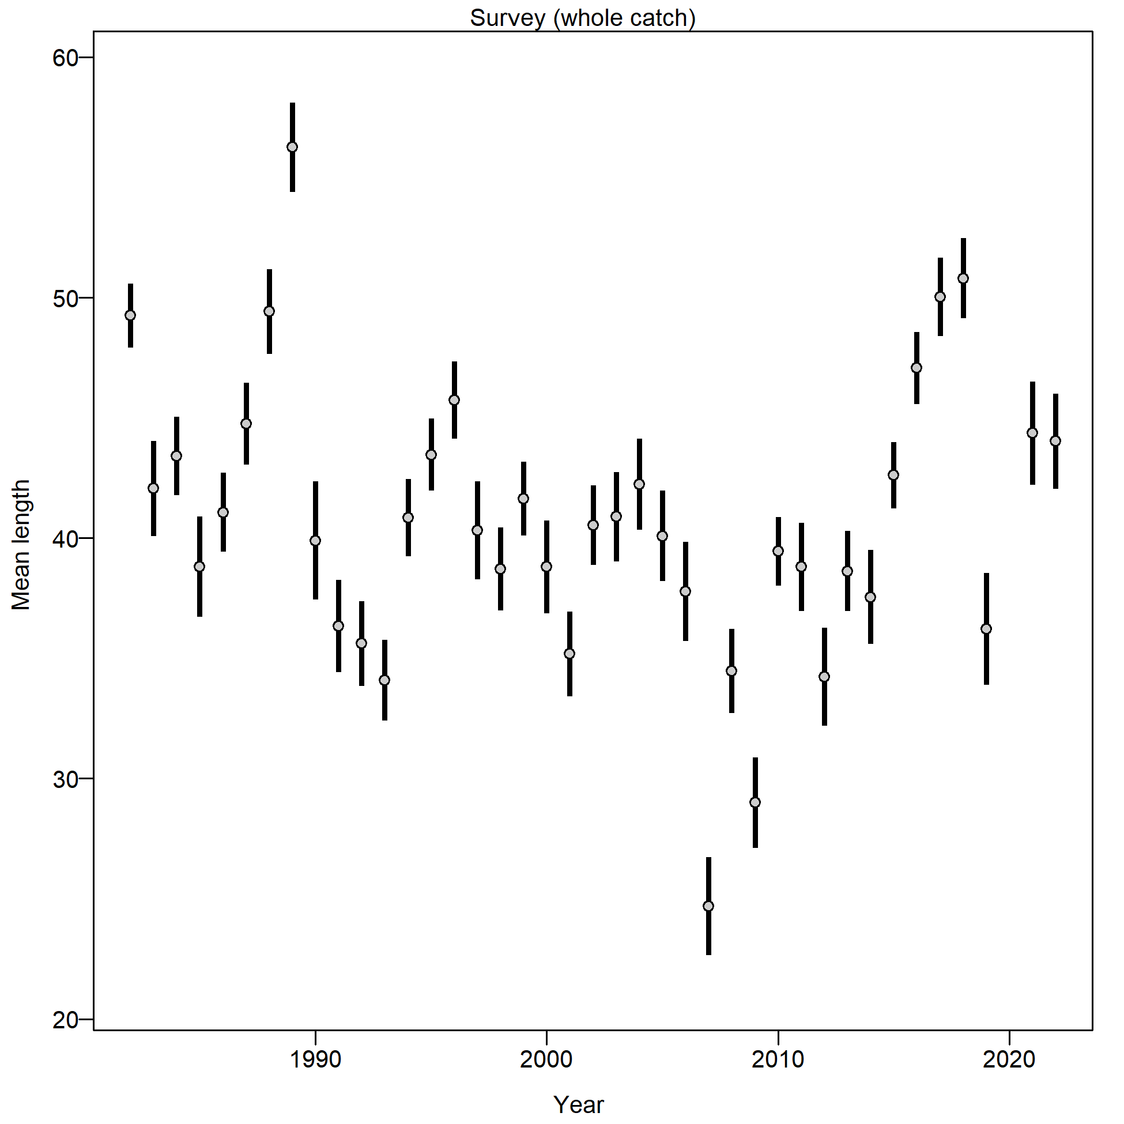
Survey Size Composition – EBS Shelf Bottom Trawl
Small fish 2018-2020 year classes evident
Notes:
Graphs of age compositions by sex (if relevant) over time followed by size compositions by sex (if relevant) over time with highlights of trends and any issues (e.g., tracking cohorts through time, shifts in size distributions, plus age group)

Slide 22
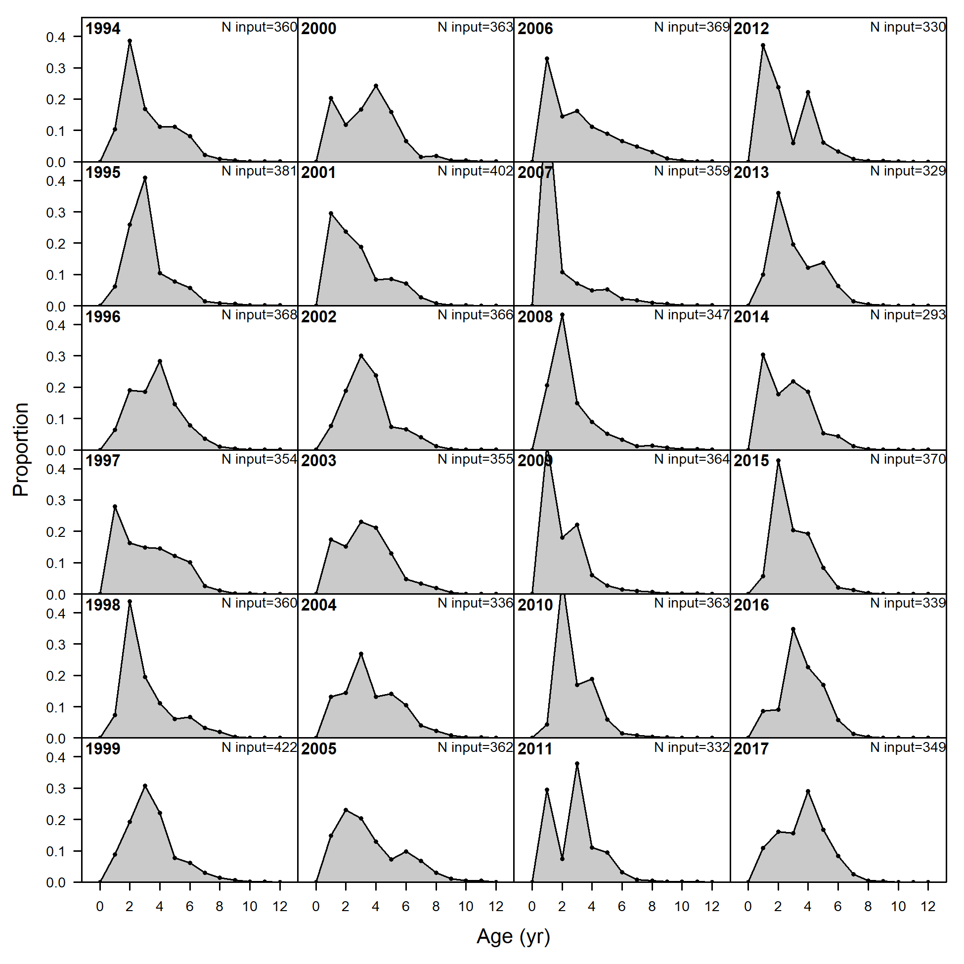
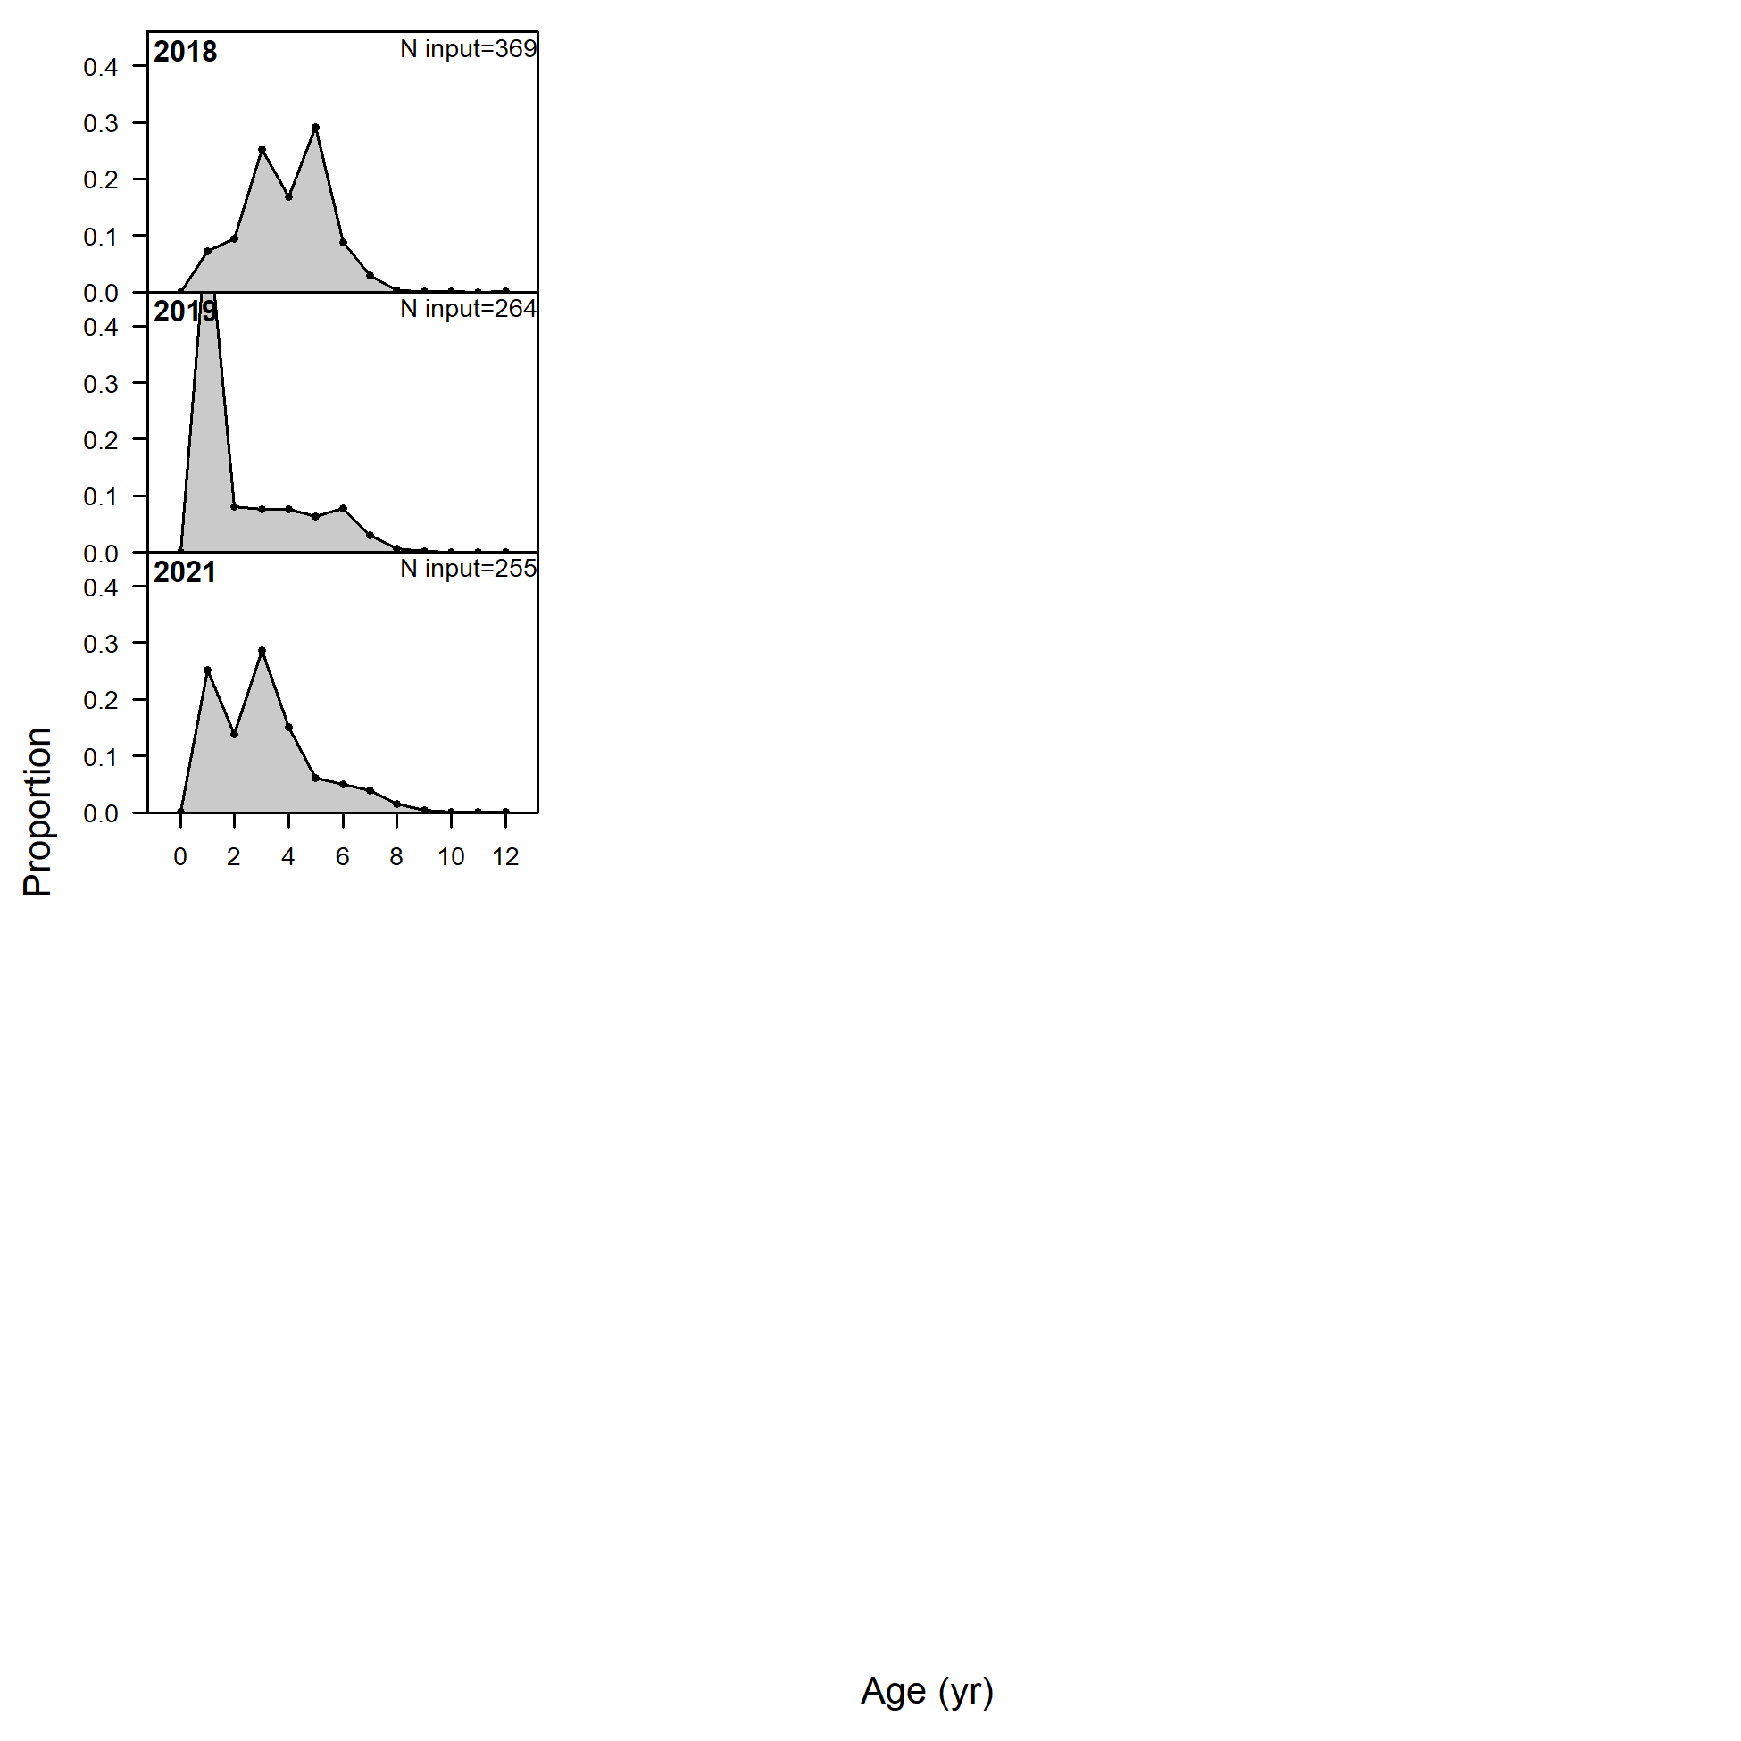
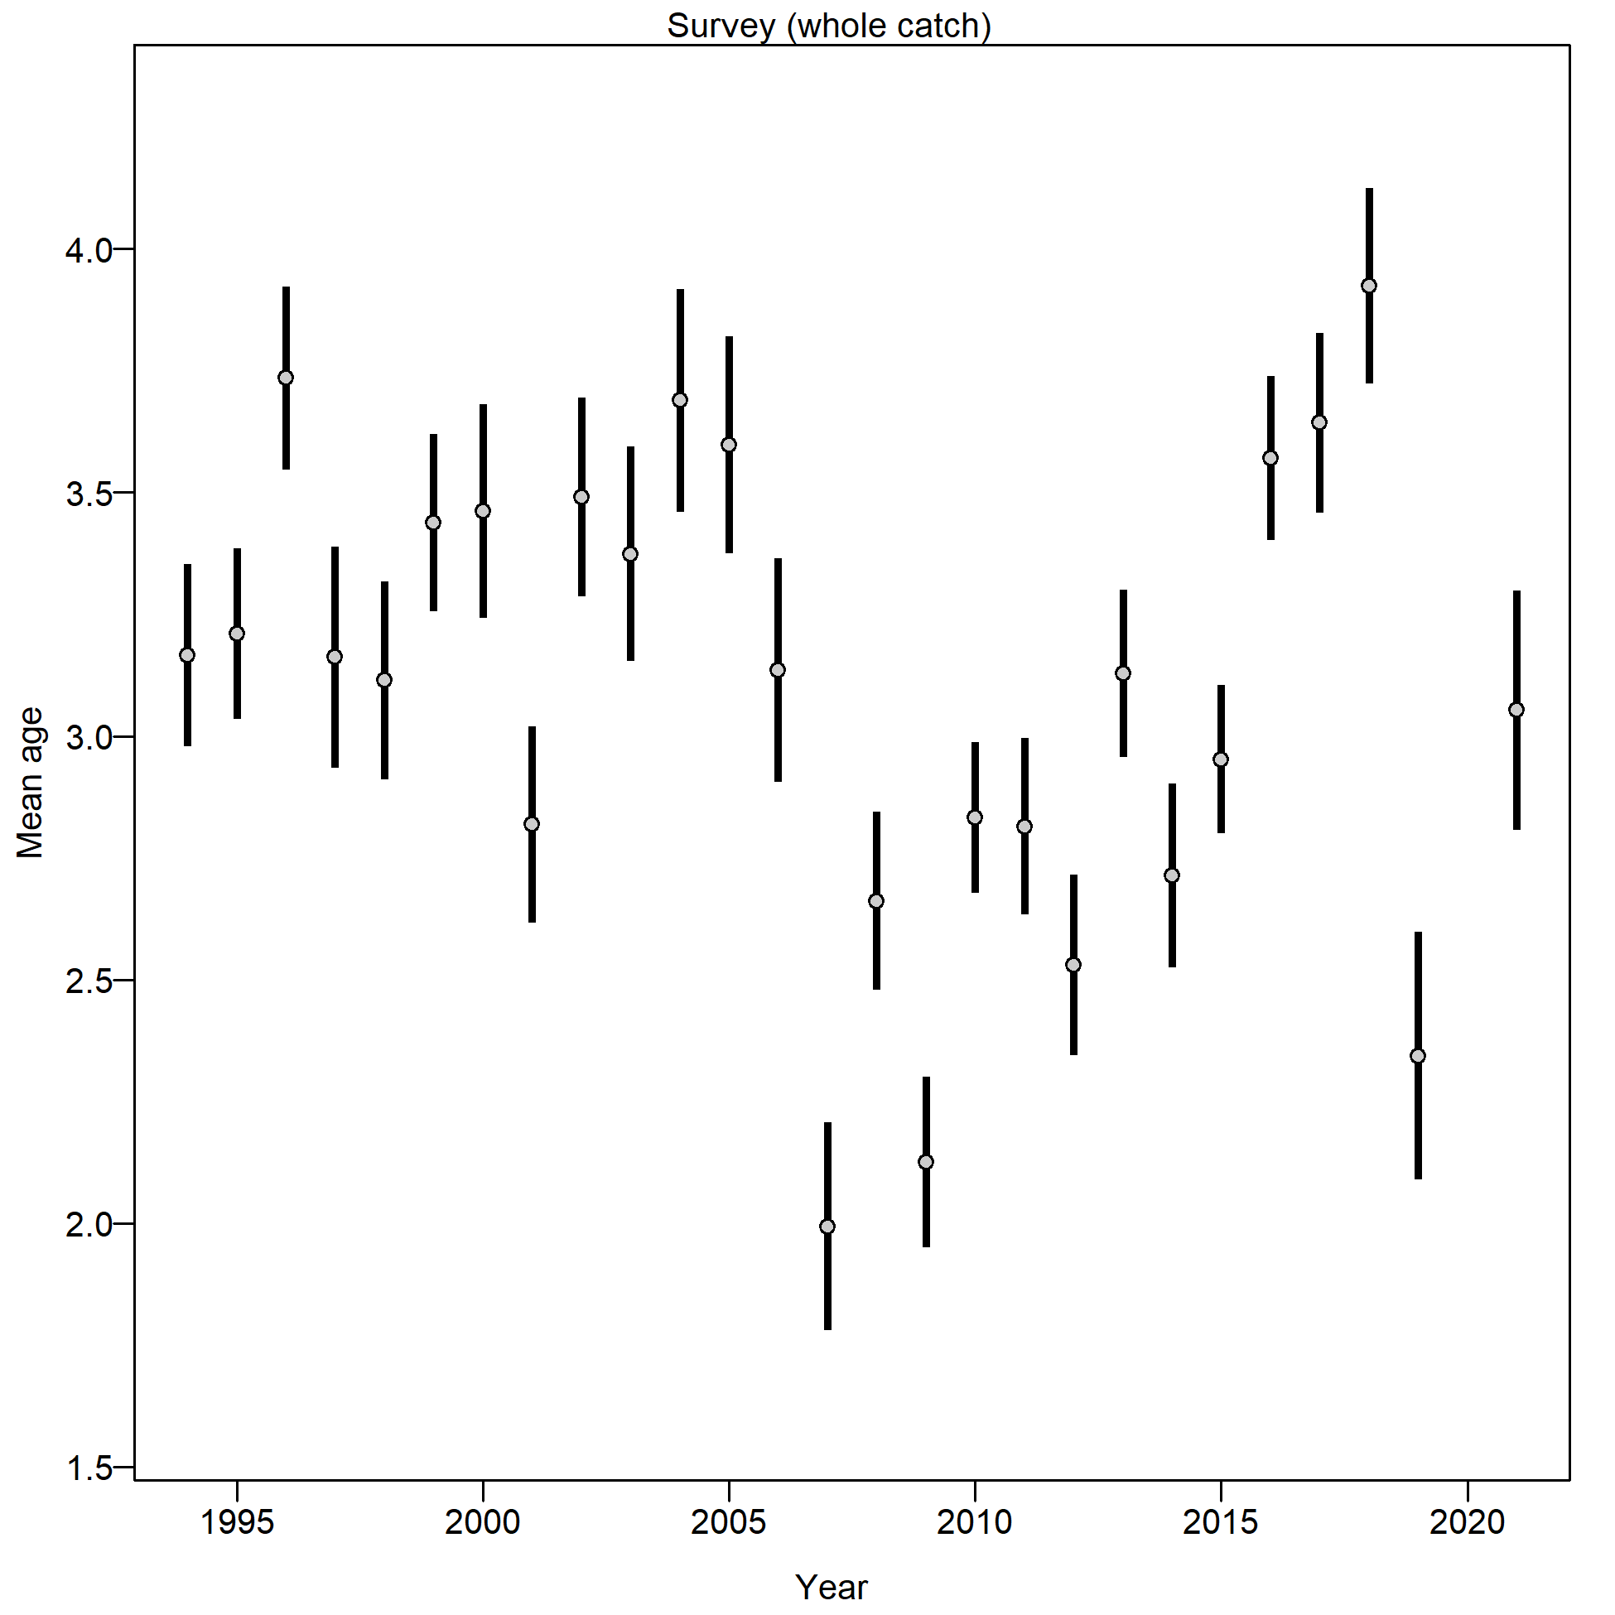
Survey Age Composition – EBS Shelf Bottom Trawl
2018 year class dominant in 2019 and 2021
2019 year class evident in 2021
Few older fish
Notes:
Graphs of age compositions by sex (if relevant) over time followed by size compositions by sex (if relevant) over time with highlights of trends and any issues (e.g., tracking cohorts through time, shifts in size distributions, plus age group)

Slide 23
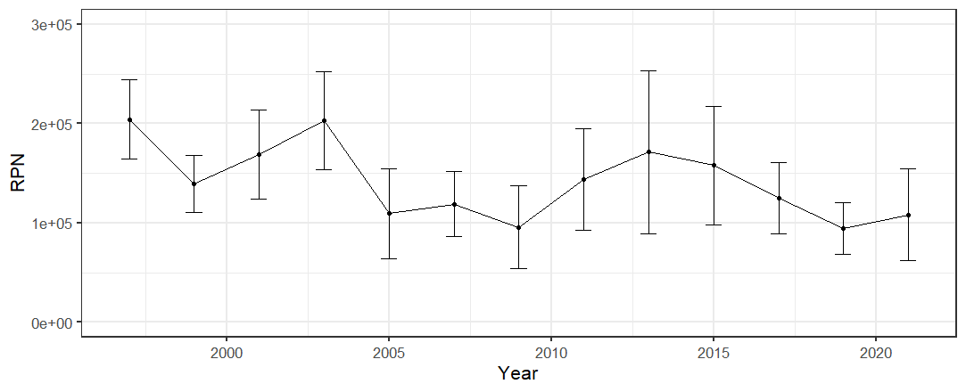
AFSC Longline Survey – Relative population numbers
Not used in models
Limited extent
2021 increase from 2019 record low
Notes:
Graphs of age compositions by sex (if relevant) over time followed by size compositions by sex (if relevant) over time with highlights of trends and any issues (e.g., tracking cohorts through time, shifts in size distributions, plus age group)

Slide 24
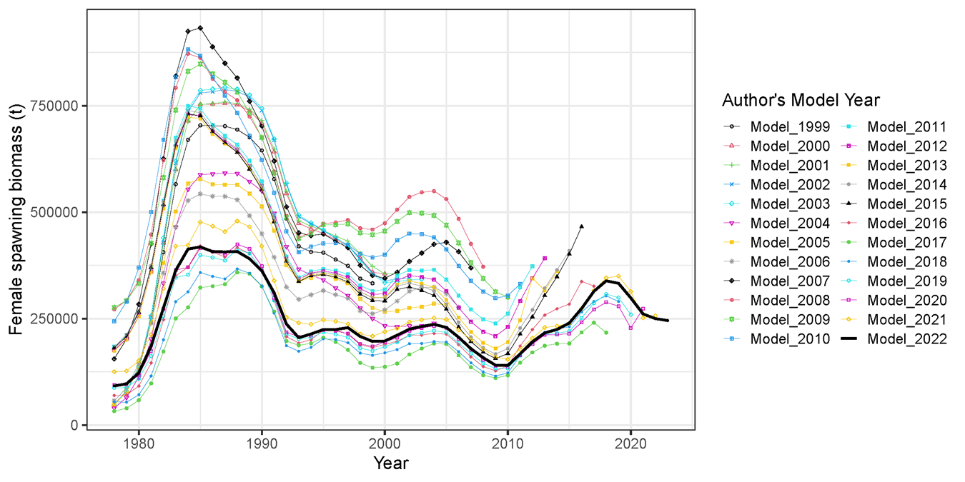
Stock Assessment Models
Diverse set of models over the past 22 years
Current base model is an ensemble of 4 models
Notes:
Graphs of age compositions by sex (if relevant) over time followed by size compositions by sex (if relevant) over time with highlights of trends and any issues (e.g., tracking cohorts through time, shifts in size distributions, plus age group)

Slide 25
Model configurations
Thompson Series models | M 19.12 | M 19.12A | M 21.1 | M 21.2
New Series models | M 22.1 | M 22.2 | M 22.3 | M 22.4
Feature 1: Allow catchability to vary? | YES | NO | NO | NO
Feature 2: Allow domed survey selectivity? | NO | NO | YES | NO
Feature 3: Use fishery CPUE? | NO | NO | NO | YES
New Series models - Same as Thompson Series models except
Seasonally corrected annual weight-at-length adjustments removed
Post-2007 aging bias block removed
Although minor model changes, substantial changes in data processing resulting in model name changes for this year.
Notes:
List or table with estimates with highlights of trends and any issues (e.g., different natural mortality estimates, changes in maturity)

Slide 26
Model weighting (same as last year)
Feature |  | M 19.12 M 22.1 | M 19.12A M 22.2 | M 21.1 M 22.3 | M 21.2 M 22.4
Feature 1: Allow catchability to vary? |  | yes | no | no | no
Feature 2: Allow domed survey selectivity? |  | no | no | yes | no
Feature 3: Use fishery CPUE? |  | no | no | no | yes
Criterion | Emph. | M 19.12 M 22.1 | M 19.12A M 22.2 | M 21.1 M 22.3 | M 21.2 M 22.4
General plausibility of the model | 3 | 1 | 2 | 0.6667 | 1
Acceptable retrospective bias | 3 | 2 | 2 | 1.3333 | 1
Uses properly vetted data | 3 | 2 | 2 | 2 | 0
Acceptable residual patterns | 3 | 2 | 2 | 2 | 2
Comparable complexity | 2 | 1 | 2 | 1 | 2
Fits consistent with variances | 2 | 2 | 1 | 1 | 0
Average emphasis: |  | 1.6875 | 1.875 | 1.375 | 1
Model weight: |  | 0.2842 | 0.3158 | 0.2316 | 0.1684
Notes:
List or table with estimates with highlights of trends and any issues (e.g., different natural mortality estimates, changes in maturity)

Slide 27

Model Fits
Exploration of individual models and their fits can be found at the link provided
Model fits and results were nearly identical between the Thompson and New Series models
Largest difference was the fit to the age composition data with a degraded fit due to the removal of the post-2007 aging bias
https://afsc-assessments.github.io/EBS_PCOD/2022_ASSESSMENT/NOVEMBER_MODELS/
Notes:
List or table with estimates with highlights of trends and any issues (e.g., different natural mortality estimates, changes in maturity)

Slide 28
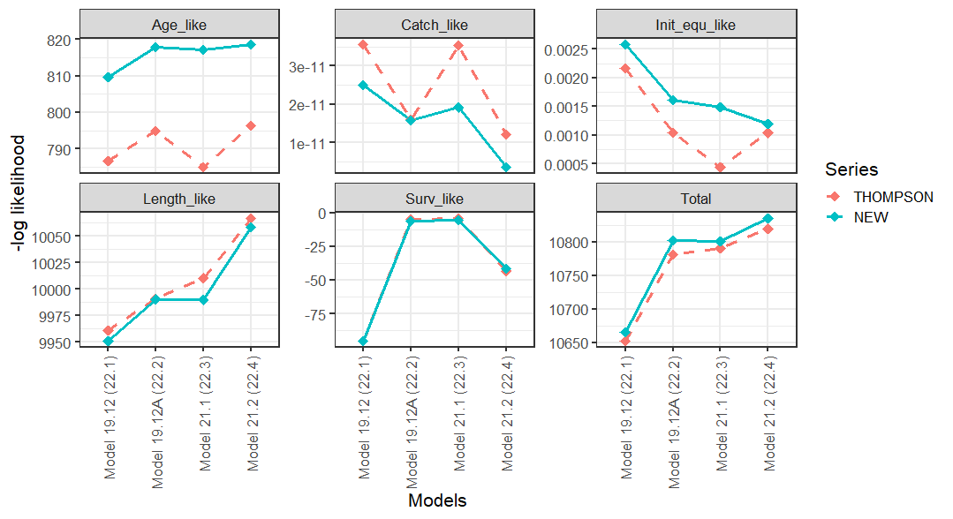
Models – Objective function
Can not compare across models in a series, but can look at between models across series
Largest difference between series is the fit to the age composition
Notes:
List or table with estimates with highlights of trends and any issues (e.g., different natural mortality estimates, changes in maturity)

Slide 29
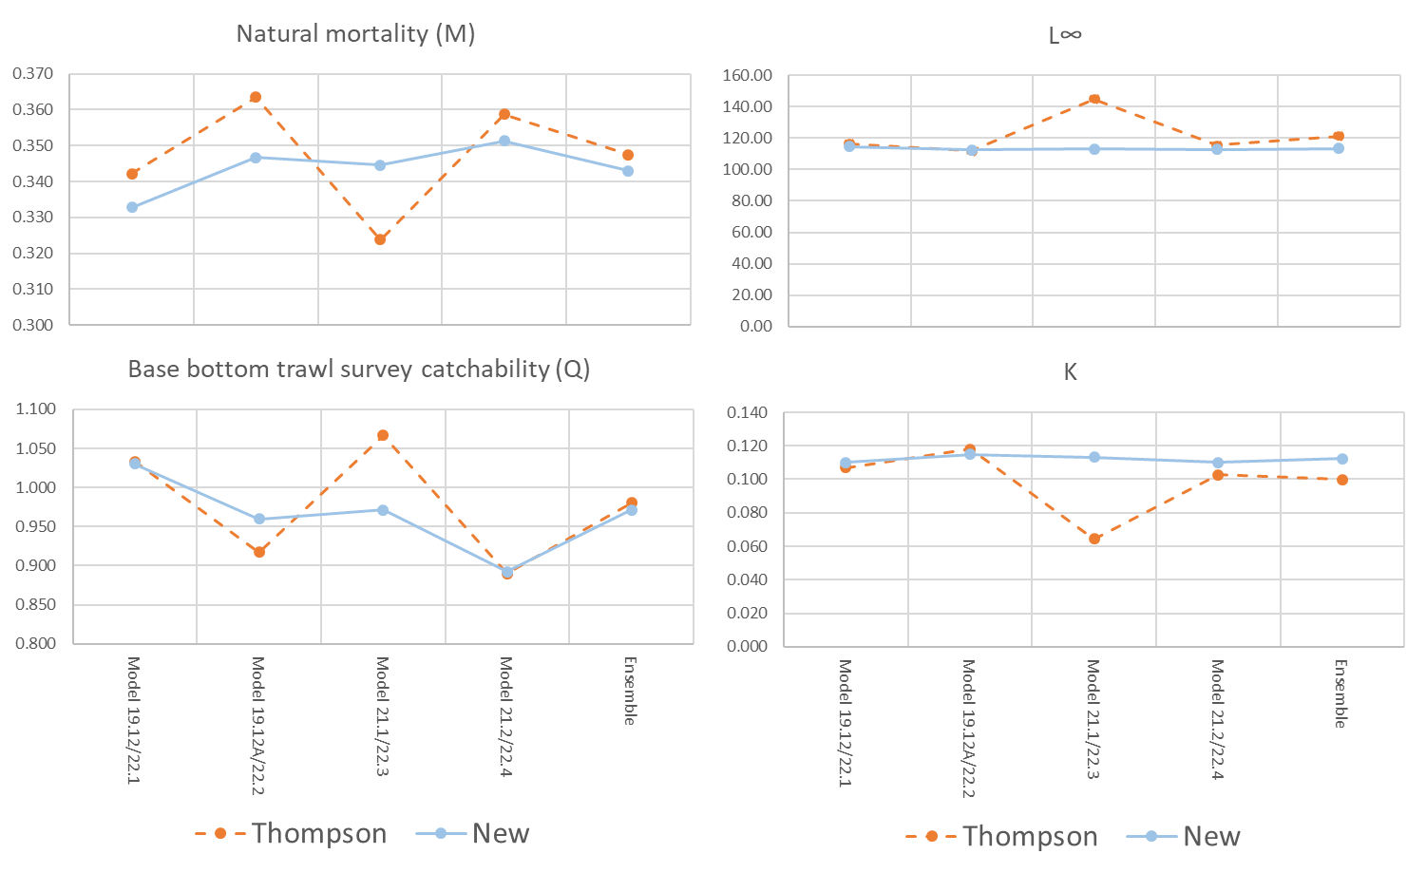
Models – Parameters
Similar values between the ensembles
Higher variability in parameters from the individual Thompson Series models
Notes:
List or table with estimates with highlights of trends and any issues (e.g., different natural mortality estimates, changes in maturity)

Slide 30
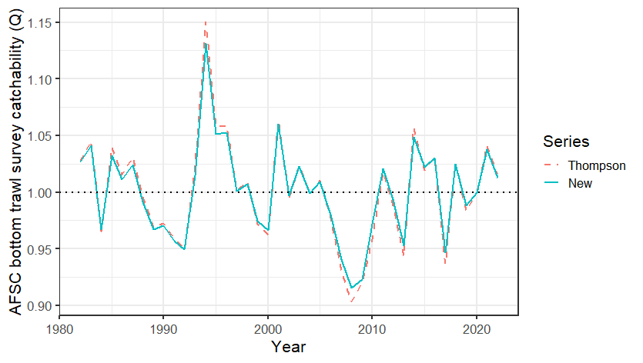
Models – Parameters (Catchability for Model 19.12 and 22.1)
Nearly identical trends
Slightly more extreme values in the Thompson series
Notes:
List or table with estimates with highlights of trends and any issues (e.g., different natural mortality estimates, changes in maturity)

Slide 31
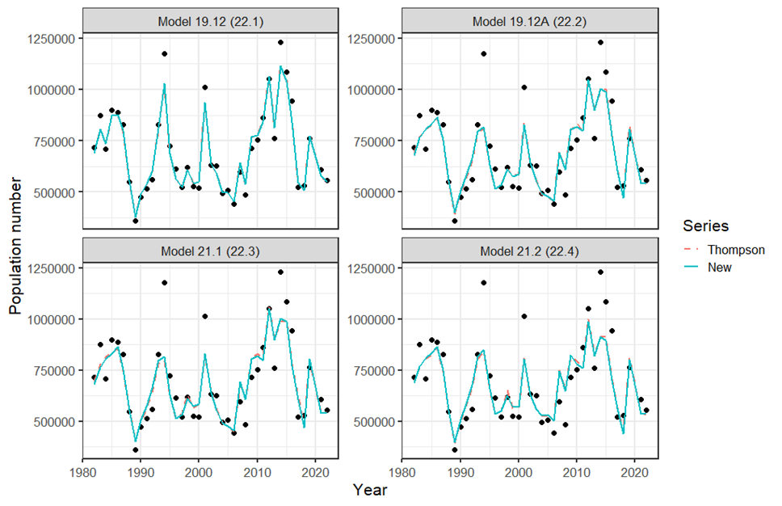
Models – Fits to AFSC bottom trawl survey
Nearly identical fits within model sets
Models 19.12 and 19.12A much tighter fit with annually varying catchability.
Worse fit in models 21.2 and 22.4 with inclusion of the CPUE index
Notes:
List or table with estimates with highlights of trends and any issues (e.g., different natural mortality estimates, changes in maturity)

Slide 32
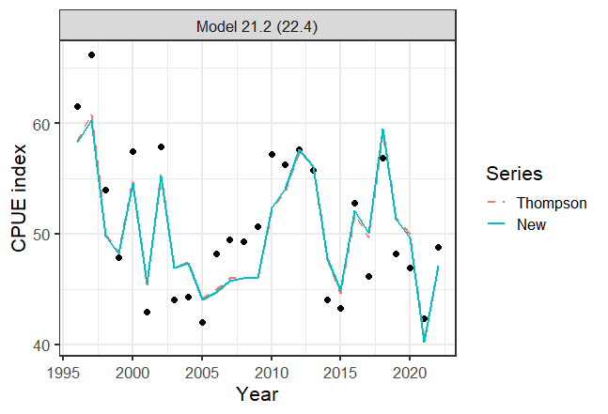
Models – Fits to winter longline fishery CPUE index
Again nearly identical fits
Notes:
List or table with estimates with highlights of trends and any issues (e.g., different natural mortality estimates, changes in maturity)

Slide 33
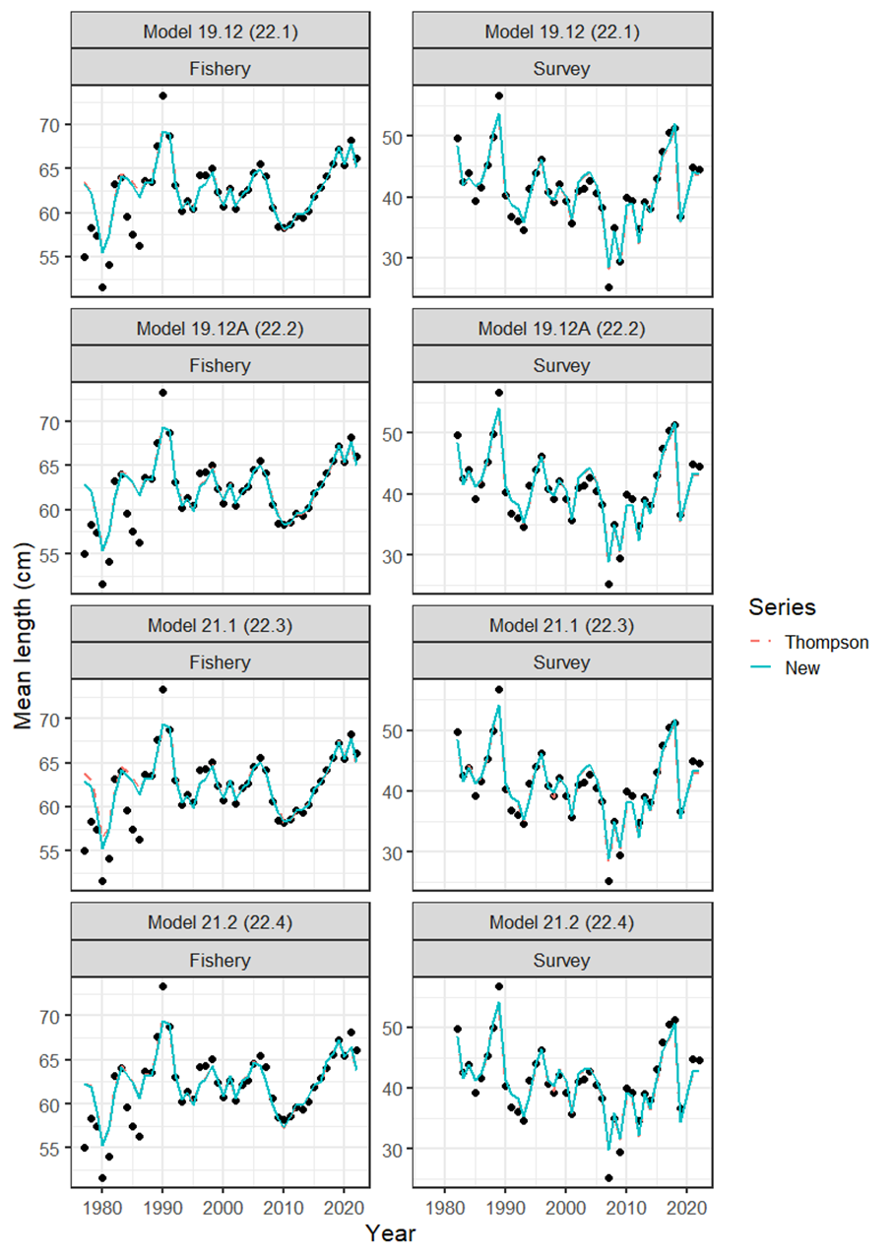
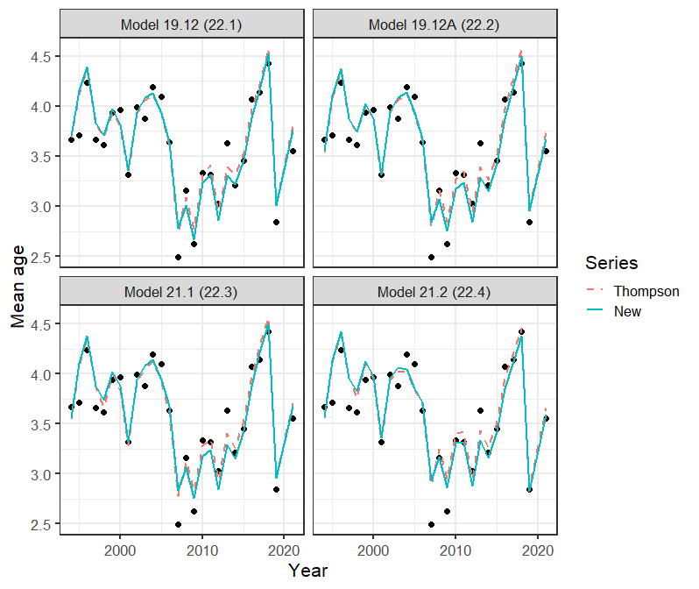
Models – Fits length and age composition data
Visually indistinguishable fits for length composition
Slightly degraded fit for the New Series ensemble models to post-2007 age composition data
Notes:
List or table with estimates with highlights of trends and any issues (e.g., different natural mortality estimates, changes in maturity)

Slide 34
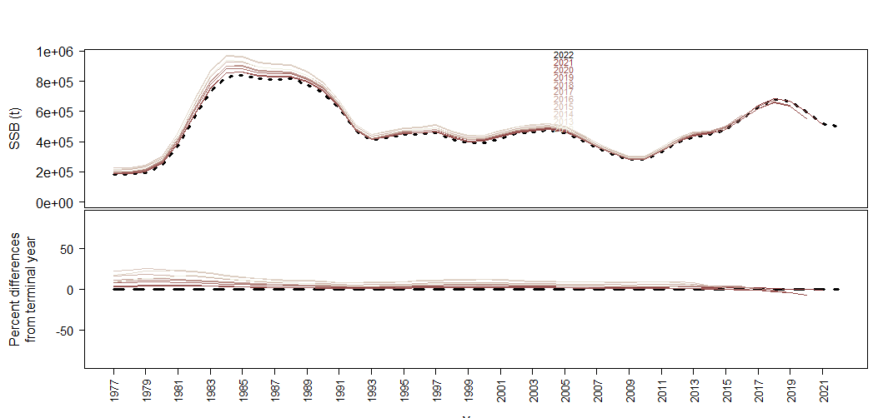
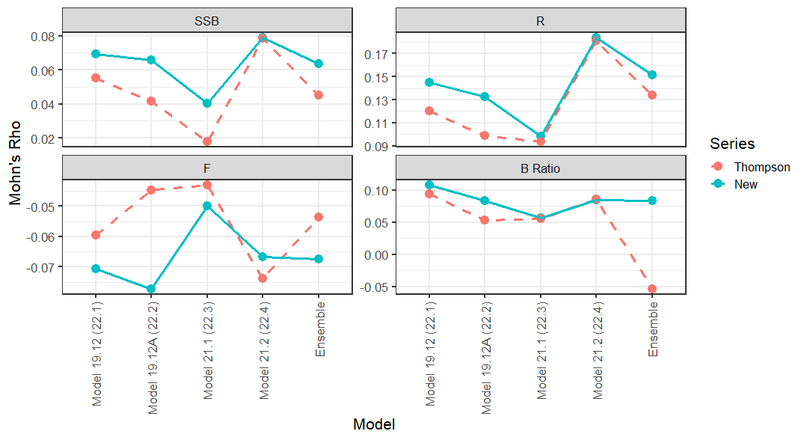
Models – Retrospective analysis
Ensemble retrospective analysis
Consistently low positive bias on Mohn’s ρ for SSB from both series
Notes:
List or table with estimates with highlights of trends and any issues (e.g., different natural mortality estimates, changes in maturity)

Slide 35






Models – Selectivity generic shapes
Fishery Selectivity
Consistent fishery selectivity shape for New Series models
Survey selectivity consistent for all asymptotic models
Small difference in survey selectivity for Model 21.1 and 22.3 which allow for dome-shape
M19.12 and M19.12A
M21.1
M21.2 and All M22.x
Survey Selectivity
M21.1
M22.3
M19.12, M19.12A, M21.2, M22.1, M22.2, and M22.4
Notes:
List or table with estimates with highlights of trends and any issues (e.g., different natural mortality estimates, changes in maturity)

Slide 36

Models – Derived quantities
As with the parameters the derived quantities are similar, but less variable for the New Series.
Ensemble values are very similar.
Notes:
List or table with estimates with highlights of trends and any issues (e.g., different natural mortality estimates, changes in maturity)

Slide 37
Models – Runs Test - indices
Model |  | Type |  | Index | p-value | Test
M19.12 |  | cpue |  | Survey | 0.266 | Passed
M19.12A |  | cpue |  | Survey | 0.280 | Passed
M21.1 |  | cpue |  | Survey | 0.100 | Passed
M21.2 |  | cpue |  | Fishery | 0.093 | Passed
M21.2 |  | cpue |  | Survey | 0.027 | Failed
M22.1 |  | cpue |  | Survey | 0.266 | Passed
M22.2 |  | cpue |  | Survey | 0.280 | Passed
M22.3 |  | cpue |  | Survey | 0.100 | Passed
M22.4 |  | cpue |  | Fishery | 0.093 | Passed
M22.4 |  | cpue |  | Survey | 0.027 | Failed
Test for autocorrelation in residuals
Both tests with the CPUE index failed the runs test for the Bottom trawl survey
All other runs passed
Notes:
List or table with estimates with highlights of trends and any issues (e.g., different natural mortality estimates, changes in maturity)

Slide 38
Models – Runs Test – Length composition
Model |  | Type |  | Index | p-value | Test
M19.12 |  | len |  | Fishery | 0.010 | Failed
M19.12 |  | len |  | Survey | 0.102 | Passed
M19.12A |  | len |  | Fishery | 0.009 | Failed
M19.12A |  | len |  | Survey | 0.001 | Failed
M21.1 |  | len |  | Fishery | 0.001 | Failed
M21.1 |  | len |  | Survey | 0.005 | Failed
M21.2 |  | len |  | Fishery | 0.000 | Failed
M21.2 |  | len |  | Survey | 0.000 | Failed
M22.1 |  | len |  | Fishery | 0.001 | Failed
M22.1 |  | len |  | Survey | 0.028 | Failed
M22.2 |  | len |  | Fishery | 0.002 | Failed
M22.2 |  | len |  | Survey | 0.000 | Failed
M22.3 |  | len |  | Fishery | 0.002 | Failed
M22.3 |  | len |  | Survey | 0.000 | Failed
M22.4 |  | len |  | Fishery | 0.000 | Failed
M22.4 |  | len |  | Survey | 0.000 | Failed
Test for autocorrelation in mean length residuals
All runs except model 19.12 survey length comps failed
Notes:
List or table with estimates with highlights of trends and any issues (e.g., different natural mortality estimates, changes in maturity)

Slide 39
Models – Runs Test – Age composition
Test for autocorrelation in mean age residuals
All Thompson Series runs passed
All New Series runs failed except for M22.1
Model |  | Type |  | Index | p-value | Test
M19.12 |  | age |  | Survey | 0.724 | Passed
M19.12A |  | age |  | Survey | 0.494 | Passed
M21.1 |  | age |  | Survey | 0.447 | Passed
M21.2 |  | age |  | Survey | 0.451 | Passed
M22.1 |  | age |  | Survey | 0.724 | Passed
M22.2 |  | age |  | Survey | 0.039 | Failed
M22.3 |  | age |  | Survey | 0.039 | Failed
M22.4 |  | age |  | Survey | 0.039 | Failed
Notes:
List or table with estimates with highlights of trends and any issues (e.g., different natural mortality estimates, changes in maturity)

Slide 40
Models – Mean absolute scaled error (MASE)
Test prediction skill (better than random walk <1.0 )
All data components passed for all models, except…
All models failed for survey length composition.
 | Index |  | Lengths |  | Age
Model | Fishery | Survey | Fishery | Survey | Survey
Model 19.12 |  | 0.19 | 0.31 | 1.23 | 0.71
Model 19.12A |  | 0.44 | 0.33 | 1.22 | 0.71
Model 21.1 |  | 0.44 | 0.34 | 1.21 | 0.68
Model 21.2 | 0.41 | 0.47 | 0.42 | 1.28 | 0.71
Model 22.1 |  | 0.20 | 0.31 | 1.22 | 0.76
Model 22.2 |  | 0.45 | 0.32 | 1.20 | 0.76
Model 22.3 |  | 0.45 | 0.32 | 1.19 | 0.75
Model 22.4 | 0.42 | 0.47 | 0.42 | 1.28 | 0.77
Notes:
List or table with estimates with highlights of trends and any issues (e.g., different natural mortality estimates, changes in maturity)

Slide 41



Models – Derived quantities
Spawning biomass slightly higher in early part for Thompson Series
Higher variability in F in Thompson Series
Bratio follows same trend as spawning biomass
Notes:
List or table with estimates with highlights of trends and any issues (e.g., different natural mortality estimates, changes in maturity)

Slide 42

New Series Results – Female spawning biomass
All four models show reduction from 2018 high point.
Model 22.4 with CPUE index indicates higher SSB earlier in the time series and lower in most recent
Notes:
List or table with estimates with highlights of trends and any issues (e.g., different natural mortality estimates, changes in maturity)

Slide 43

New Series Results – Female spawning biomass
High point in the mid to late 1980s
Low point in 2010 at B_{21%}
Currently below B_{40%}
Notes:
List or table with estimates with highlights of trends and any issues (e.g., different natural mortality estimates, changes in maturity)

Slide 44

New Series Results – Age-0 recruitment
Large 2018 year class
2014-2017, 2019, and 2020 estimated to be below average
2021 and 2022 set at ~R₀ as not yet well defined in the data.
Notes:
List or table with estimates with highlights of trends and any issues (e.g., different natural mortality estimates, changes in maturity)

Slide 45

New Series Results – Apical fishing mortality
High fishing mortality from 2008-2016 with dome-shaped survey selectivity
Drop in F 2017-2021 change to asymptotic survey selectivity.
Increase in 2022 due again to change in model with ensemble
Notes:
List or table with estimates with highlights of trends and any issues (e.g., different natural mortality estimates, changes in maturity)

Slide 46

Phase Plane
High fishing mortality from 2008-2016 with dome-shaped survey selectivity
Drop in F 2017-2021 change to asymptotic survey selectivity.
Increase in 2022 due again to change in model with ensemble
Notes:
Plot of fishing mortality rate relative to F35% and female spawning biomass relative for B 35% for status

Slide 47

Risk Table
Notes:
Summary table with brief summary of justification text or plots for selected levels of risk, if have ESP for stock and presentation preceding then can simply reference ESP graphs

Slide 48

New Series ensemble – Projection scenarios
Not overfishing
Not overfished
Not approaching an overfished condition
With average recruitment projected decline through 2026
Notes:
Model graph of Spawning Stock Biomass with B40% and B35% reference lines

Slide 49

Harvest Recommendation
Year | Quantity | Last Year | New Series | Change
 | B_{100%} | 686,761 | 668,477 | -2.70%
2023 | Tot Biom Age 0+ | 848,615 | 844,578 | -0.50%
2023 | B₂₀₂₃ | 254,585 | 245,594 | -3.50%
2023 | B% | 0.370 | 0.367 | -0.80%
2023 | maxF_{ABC} | 0.310 | 0.293 | -5.50%
2023 | maxABC | 151,709 | 144,834 | -4.50%
2024 | Tot biom Age 0+ |  | 831,566
2024 | B₂₀₂₄ |  | 242,911
2024 | B% |  | 0.364
2024 | maxF_{ABC} |  | 0.29
2024 | maxABC |  | 140,159
Notes:
Summary table with last year and recommendation for this year values, highlight ABC and OFL

Slide 50





Harvest Recommendation
B_{37%}
B_{36%}
144.8 KT
140.2 KT
Notes:
Summary table with last year and recommendation for this year values, highlight ABC and OFL

Slide 51
QUESTIONS?

Slide 52
Thanks to the many Contributors to this assessment
Caitlin Allen-Akselrud, Kerim Aydin, Mathew Callahan, Curry Cunningham, Lucas DeFilippo, Bridget Ferriss, Ben Fissel, Madison Hall, Kirstin Holsman, Tom Hurst, Kelly Kearney, Ben Laurel, Cecilia A. O’Leary, Beth Matta, Susanne McDermott, Sandi Neidetcher, Jens Nielsen, Kimberly Rand, Patrick Ressler, Heather Renner, Sean Rohan, Katie Sweeney, James Thorson, Muyin Wang, Jordan Watson, Sarah Wise, and Stephani Zador
Notes:
Table filled out using author recommended model

Slide 53
Model configurations
Label | Model 19.12 | Model 19.12A | Model 21.1 | Model 21.2 | Ensemble
# parameters | 348 | 306 | 310 | 307
LN(R₀) | 13.074 | 13.260 | 12.987 | 13.253 | 13.142
Natural mortality (M) | 0.342 | 0.363 | 0.324 | 0.359 | 0.347
L∞ | 116.345 | 111.848 | 144.934 | 115.542 | 121.411
VonBert K | 0.107 | 0.118 | 0.064 | 0.103 | 0.100
Bratio 2021 | 0.374 | 0.415 | 0.349 | 0.368 | 0.380
SPRratio 2020 | 0.583 | 0.538 | 0.603 | 0.564 | 0.570
Q Bottom trawl survey | 1.033 | 0.917 | 1.067 | 0.890 | 0.978
B_{100%} (10⁶ t) | 0.654 | 0.639 | 0.789 | 0.647 | 0.679
F_{40%} | 0.301 | 0.349 | 0.278 | 0.353 | 0.320
F_{35%} | 0.367 | 0.425 | 0.331 | 0.429 | 0.388
Notes:
List or table with estimates with highlights of trends and any issues (e.g., different natural mortality estimates, changes in maturity)

Slide 54
Model configurations
Label | Model 22.1 | Model 22.2 | Model 22.3 | Model 22.4 | Ensemble
# parameters | 346 | 304 | 308 | 305
LN(R₀) | 13.041 | 13.156 | 13.139 | 13.225 | 13.131
Natural mortality (M) | 0.333 | 0.347 | 0.345 | 0.351 | 0.343
L∞ | 114.768 | 112.387 | 113.007 | 112.786 | 113.274
VonBert K | 0.110 | 0.115 | 0.113 | 0.110 | 0.112
Bratio 2021 | 0.380 | 0.404 | 0.398 | 0.374 | 0.391
SPRratio 2020 | 0.583 | 0.556 | 0.562 | 0.564 | 0.566
Q Bottom trawl survey | 1.030 | 0.960 | 0.971 | 0.892 | 0.969
B_{100%} (10⁶ t) | 0.681 | 0.662 | 0.665 | 0.665 | 0.669
F_{40%} | 0.304 | 0.326 | 0.322 | 0.335 | 0.320
F_{35%} | 0.369 | 0.396 | 0.3911 | 0.407 | 0.389
Notes:
List or table with estimates with highlights of trends and any issues (e.g., different natural mortality estimates, changes in maturity)

